Slide 1
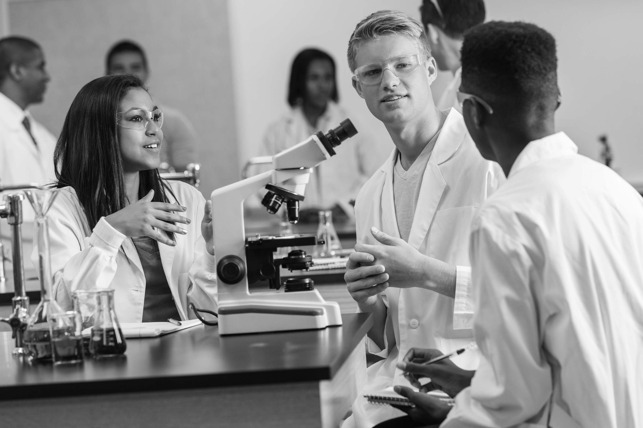
BEATING MOSQUITOES AT THEIR OWN GAME

Slide 2
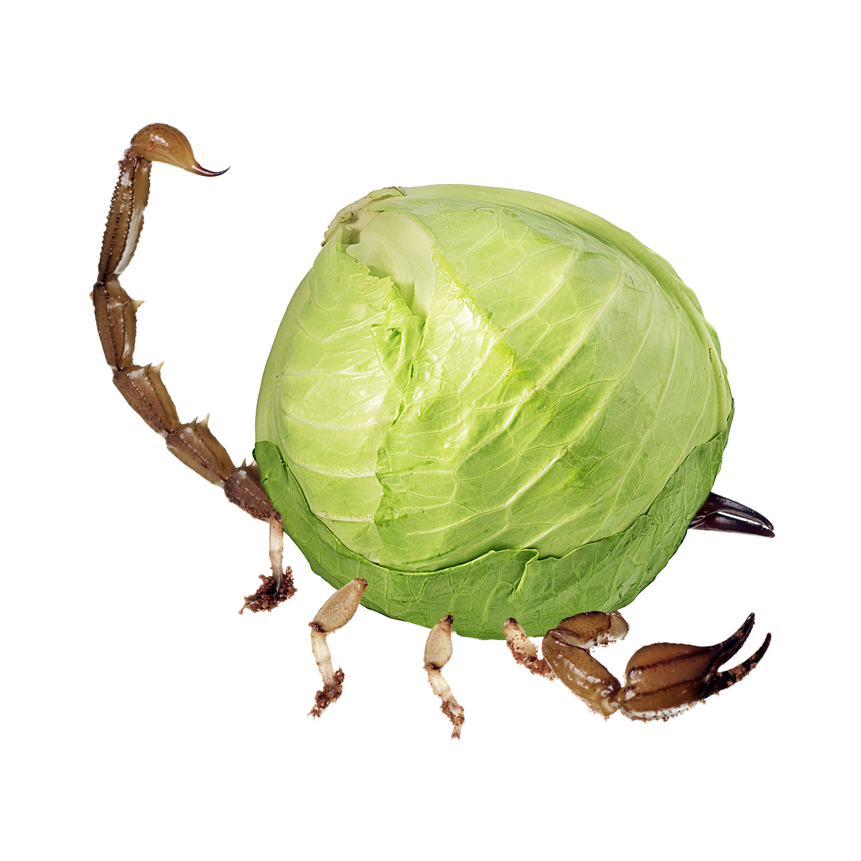
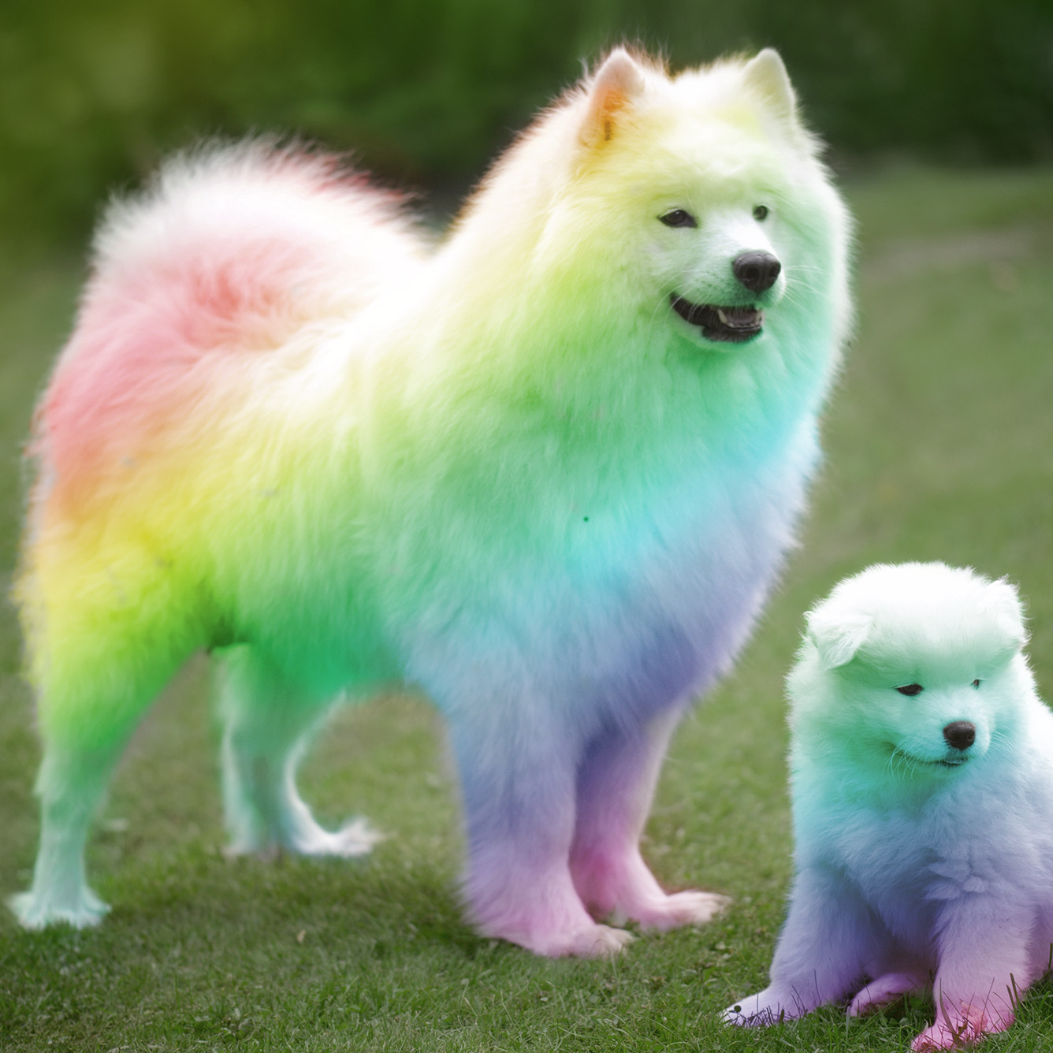
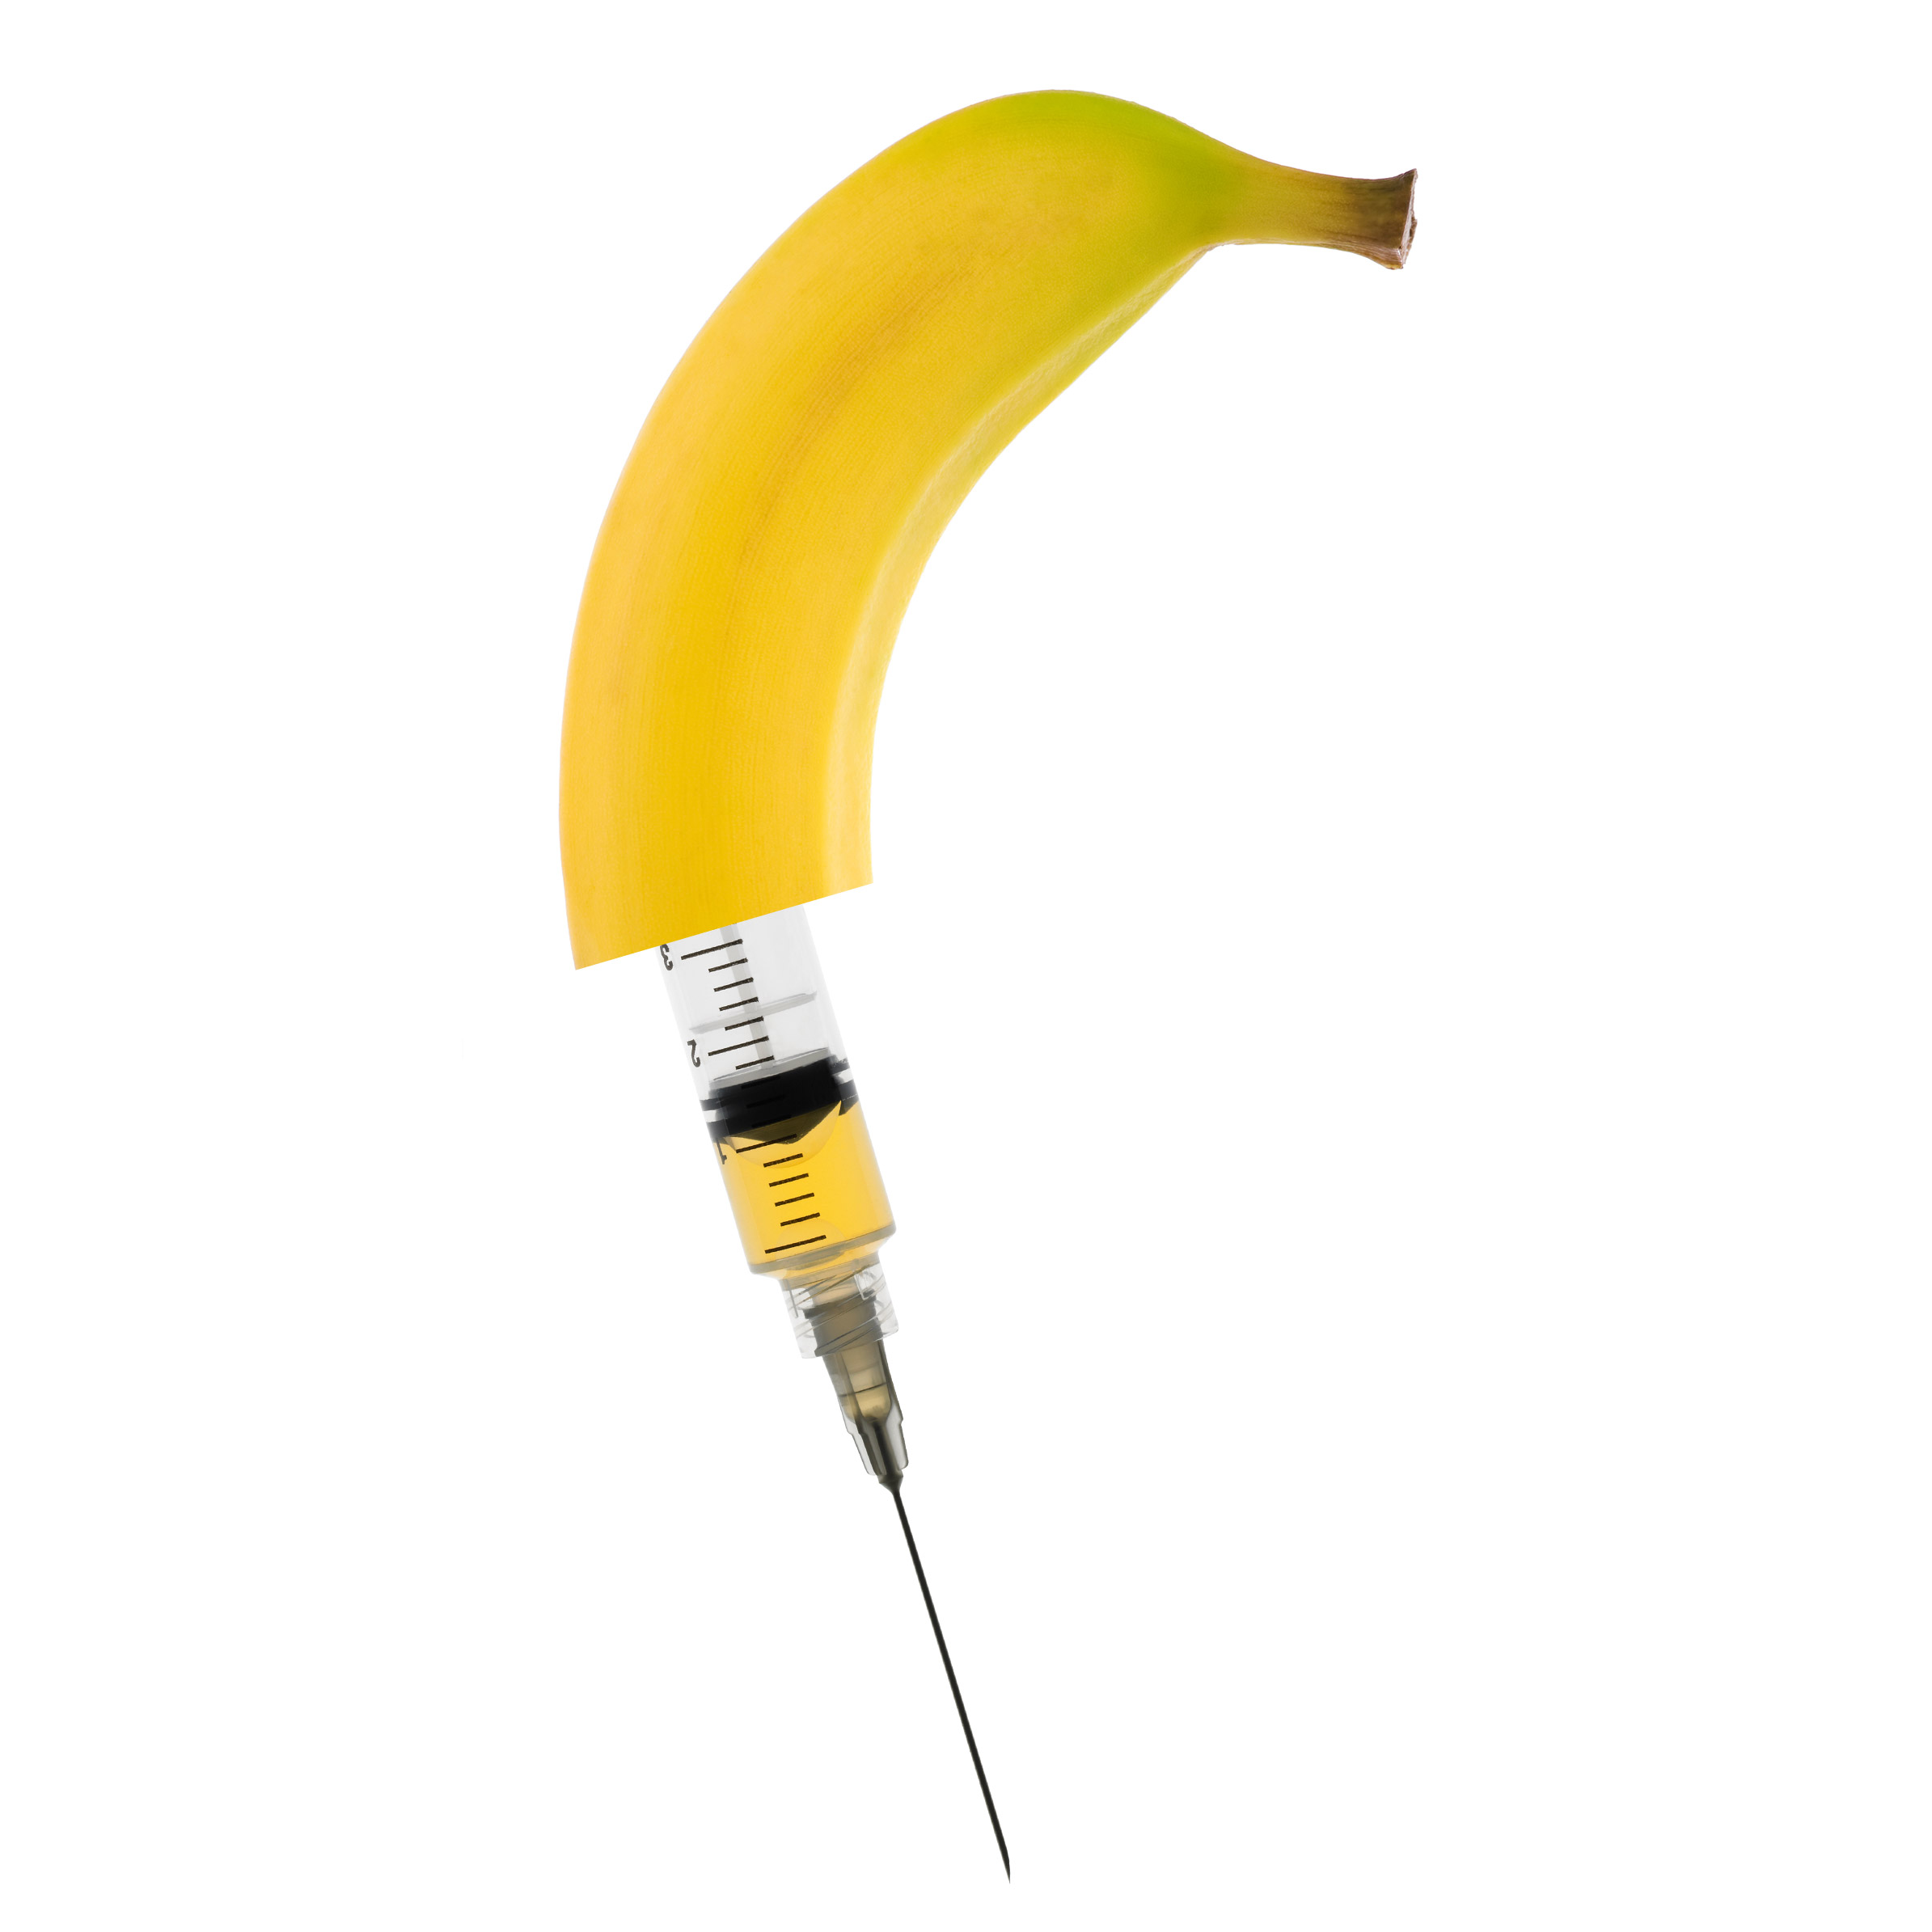
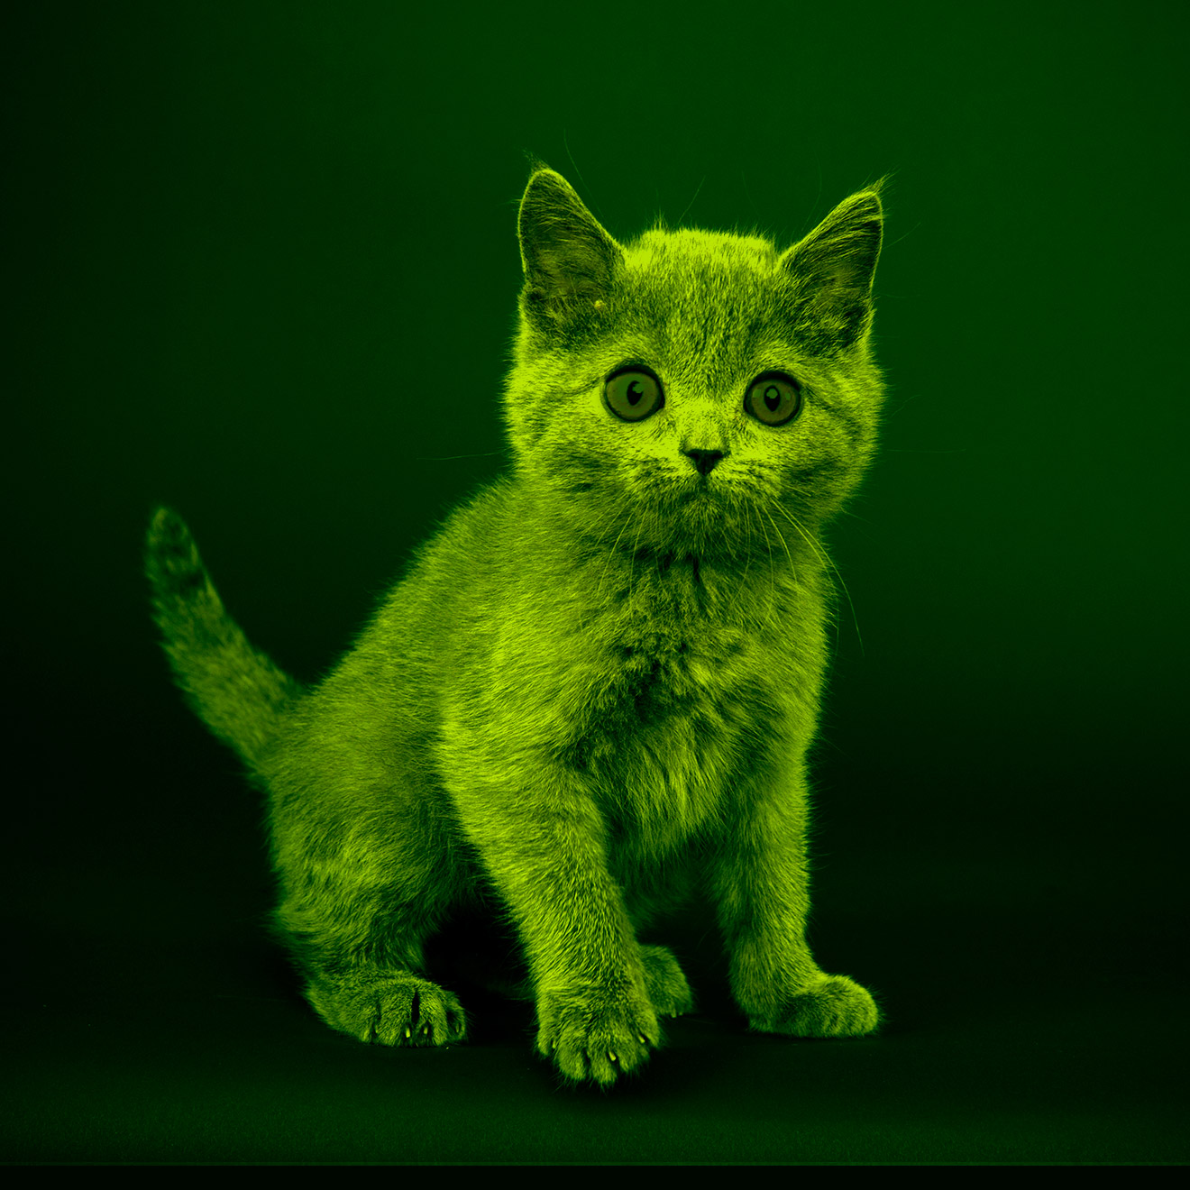
3 TRUTHS AND 1 LIE
Scientists have created:
Poisonous cabbage that produces a scorpion toxin to kill caterpillars. Truth or Lie?
Dogs that naturally grow rainbow-colored fur. Truth or Lie?
Bananas that, when eaten, have the same effect as vaccines. Truth or Lie?
Cats that glow in the dark.
Truth or Lie?
Lie!
This genetic mutation has not (yet) occurred.
Truth!
Scientists have inserted the poison gene from scorpion tails into cabbage to deter caterpillars from eating it!
Truth!
When banana saplings are injected with an altered form of a virus, its fruit becomes full of virus proteins and works like a regular vaccine.
Truth!
To help researchers study human disease better, domestic cats were bred with a gene from jellyfish that makes them glow under ultraviolet (black) light!

Slide 3

TAKE A STANCE
Considering your stance from before and the new information introduced in the video, what are some of the potential benefits and considerations of being able to influence the traits of organisms?
Did anything in the video make you change or reconsider your opinion?
Agree/Disagree Line:
Considering the three truths, do you agree or disagree with humans influencing the traits of organisms?
Watch Video

Slide 4
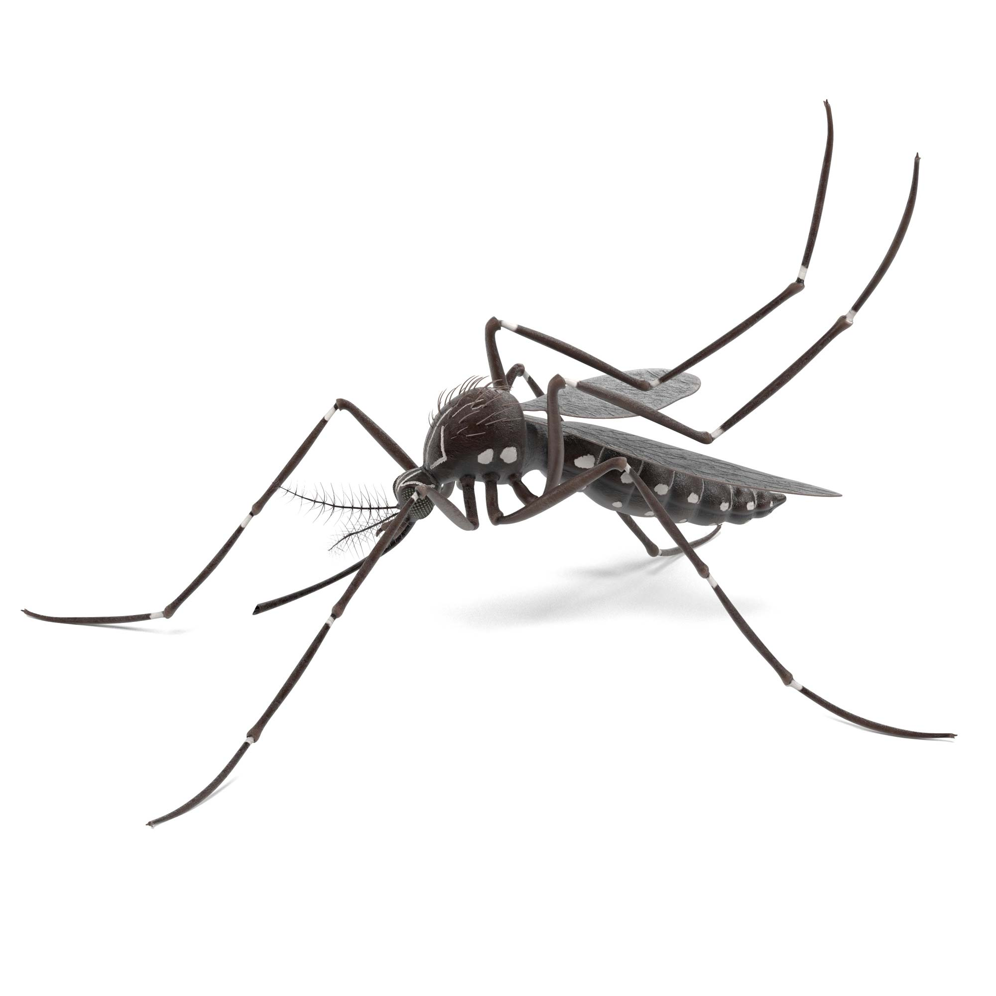
BREAKING NEWS
Just In!: The CDC has just announced a Zika outbreak in your area. In addition, they’re reporting that the population of Aedes aegypti mosquitos has reached alarming levels.
  Scientists have been using a variety of approaches to modify mosquitos in order to halt its spread.
  After learning more about the role mosquitos play in transmitting this extremely dangerous disease and the strategies scientists are trying to prevent it from spreading, you will take a position on one of the strategies and debate with your fellow classmates to arrive at a recommended approach to combat this local health crisis.
Watch Video

Slide 5
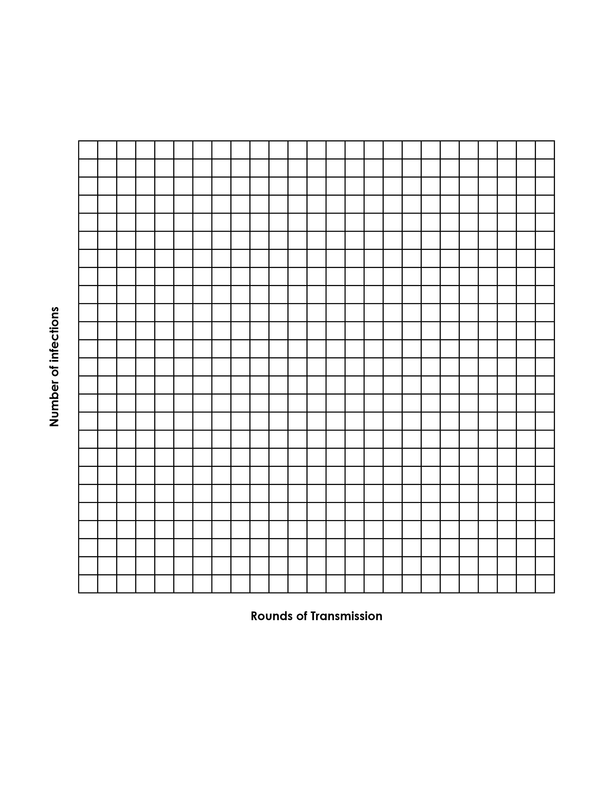
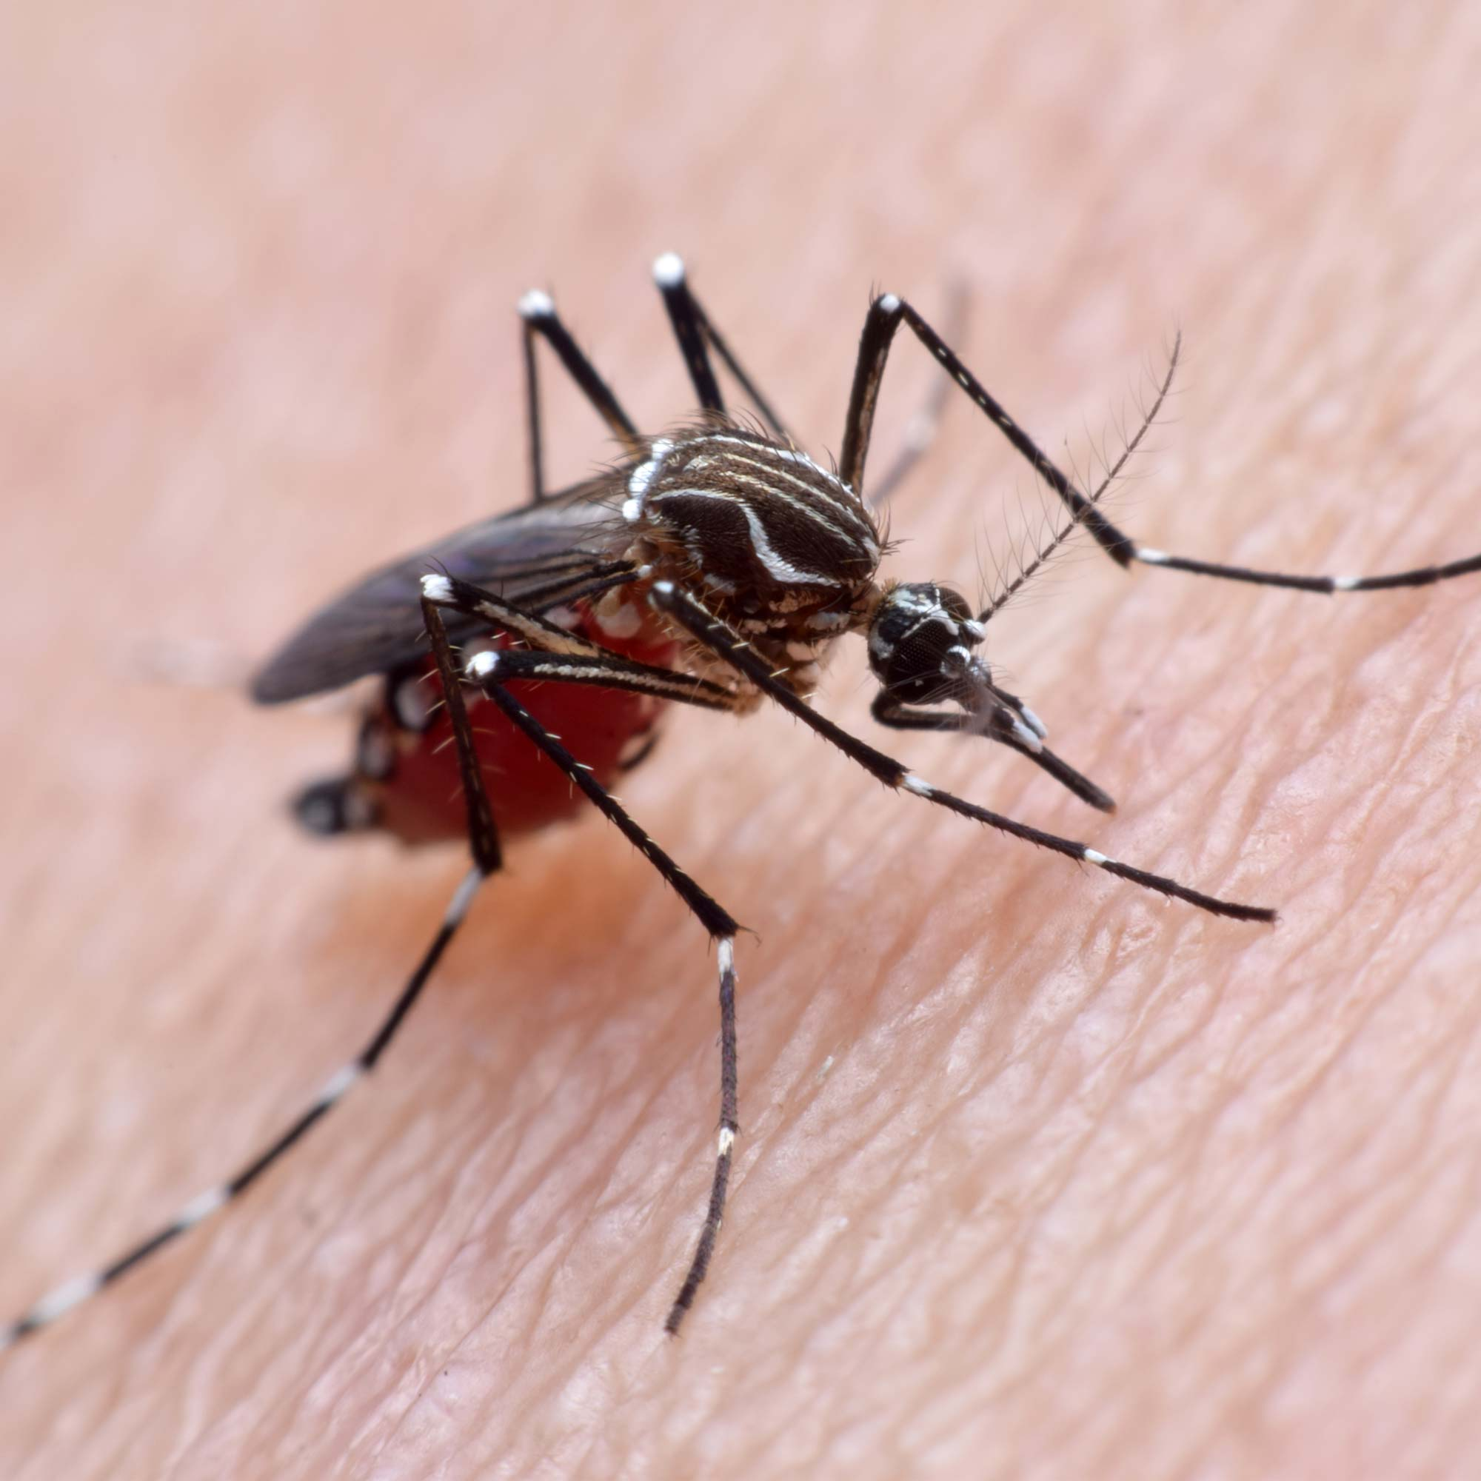
HOW ARE INFECTIOUS DISEASES SPREAD?
What do you notice about the transmission process?
Number Infected Vs. Rounds of Transmission
Use your droppers to exchange some of your vial’s contents with a classmate only when instructed to do so. This will simulate the transmission of infected disease.
Your vial represents you and your droppers represent a mosquito!

Slide 6

GUIDING QUESTION: HOW ARE MOSQUITOES USED TO EXAMINE DISEASES & TREATMENTS?
Reading Directions:
After you read the passage with your partner, record its main idea and two details that support this main idea on your Capture Sheet.
Tip: It may be helpful to annotate as you read to help you determine the main idea!
Discussion Guidelines:
Listen as each group member shares their passage’s main idea and supporting details.
Ask clarifying questions as needed.
Once each group member has shared, work together to develop an answer to the guiding question. Record your answer on your Capture Sheet.

Slide 7
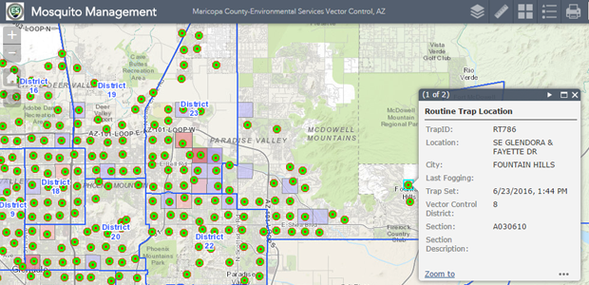
WHAT STRATEGIES ARE SCIENTISTS USING TO STOP MOSQUITOES FROM SPREADING DISEASE?
Game Directions:
Once you have marked your mosquito locations on your Home Territory grid, find a partner.
With your partner, take turns figuring out where to spray insecticide in their neighborhood by guessing street coordinators. For instance: Should I spray the corner of 5th Street and 3rd Avenue?
If your partner has a site at that coordinate, they will explain what is at that location. If there is nothing at that coordinate, they will say “Miss.”
The guesser should keep track of all hits and misses on their Investigation Grid.
Partners should continue taking turns for 5 minutes, with the goal of accomplishing the most “hits.”
Mosquito Tracker Set Up Instructions:
On your Home Territory grid, secretly choose a location for the following sites and label the squares accordingly:
3 mosquito sightings (1 square each)
2 areas of standing water (1 square each)
1 storm drain (1 square)
2 areas where insecticide cannot be sprayed (3 squares each)
Tip: It may be helpful to label each square with initials (For example: SW for standing water!)

Slide 8

MOSQUITO CONTROL TECHNIQUES
Sentence Starter: One mosquito control technique that I researched is called
______________________________
and it controls mosquitos by _________________.
Class List:

Slide 9
GUIDING QUESTION: WHAT ARE THE POTENTIAL PROS AND CONS OF GENETICALLY MODIFIED ORGANISMS?
Directions:
Read the article with your group and annotate for the guiding question.
Use your annotations to record the following information on your Student Capture Sheet:
  The main idea of the article
  At least one potential benefit (pro) and one consideration (con)
3. Be ready to share your findings!
Pros
Cons

Slide 10
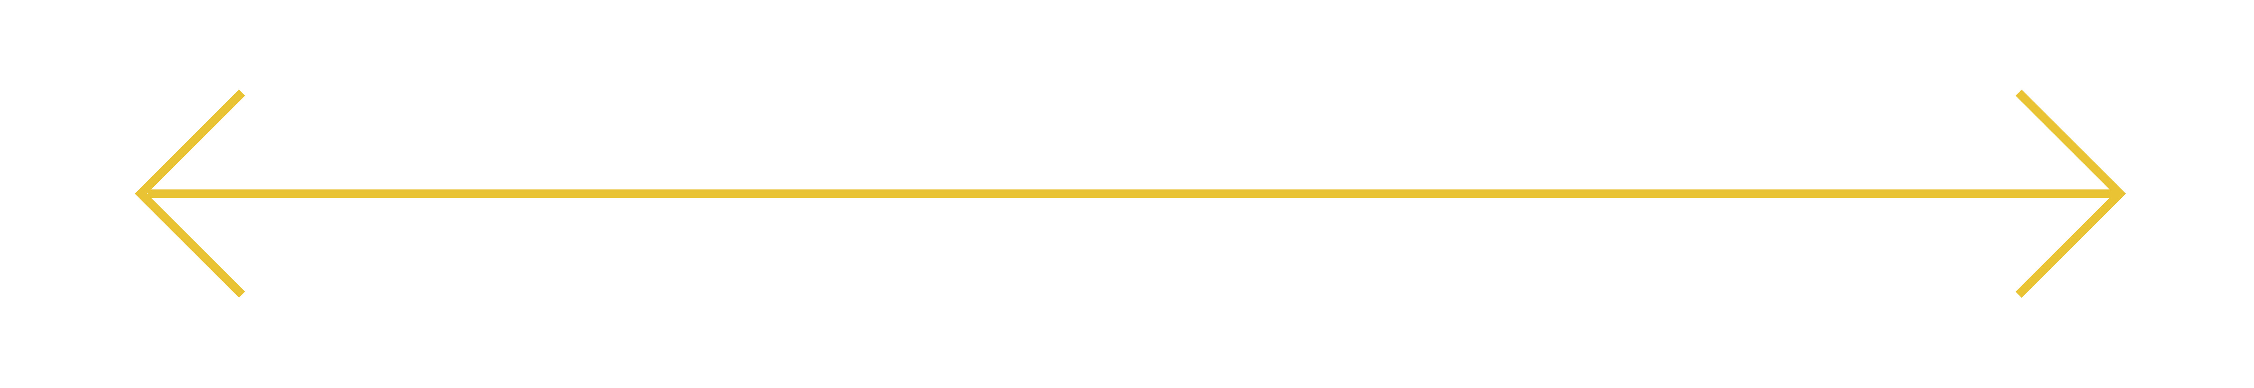
DO YOU AGREE OR DISAGREE WITH HUMANS INFLUENCING THE TRAITS OF ORGANISMS?
Agree
Neutral
Disagree

Slide 11

DEBATE PREP: STEP 1 – TAKE A STANCE

Slide 12

DEBATE PREP: STEPS 2, 3 AND 4

Slide 13

DEBATE TIME: WHAT IS THE BEST WAY TO COMBAT ZIKA TRANSMISSION IN OUR COMMUNITY?

Slide 14
COMMUNITY MOSQUITO CONTROL: ARRIVING AT A FINAL DECISION
Group Ideas:
______________________________
______________________________
______________________________
______________________________
______________________________
______________________________
______________________________
______________________________
Strongly
Agree
Disagree
Agree
Strongly
Disagree

Slide 15

COMMUNITY MOSQUITO CONTROL: FINAL VOTE
Option 1: ______________________________
Option 2: ______________________________
The winning mosquito control technique is…

Slide 16
EXTENSION ACTIVITIES
  Become Disease Detectives: Rack up points as you try to solve outbreaks that get trickier and trickier as you progress. Click here to give it a try!
  Experiment with genetic modifications as a DNA scientist: Conduct a Virtual Lab on bacterial transformation and insert new genes into bacteria. Click here to get started!

