Slide 1
VIDEO GAME DESIGN

Slide 2
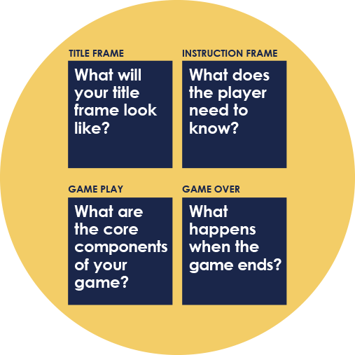
OBJECTIVES
Together, we will learn:
The basic elements of a video game and how games have evolved over time.
Why video games are important— the benefits that games provide to society and careers in the gaming industry.
How algorithms use logical expressions like if-then statements and loops to build games.
To map out our own games by creating concepts and implementing them using code.

Slide 3
THE HISTORY OF VIDEO GAMES
Tennis for Two
z
Super Mario Bros.
Angry Birds
Electronic Delay Storage Automatic Calculator (EDSAC) was the first practical stored program electronic computer
Pac Man
Super Nintendo
Xbox
Overwatch
Pong
1952
1978
1984
1989
1997
2013
1949
1958
1972
1980
1986
1991
2001
2009
2016+
Atari
Xbox One,
Playstation 4
Tetris
Final Fantasy VII
Noughts and Crosses
Gameboy
How have computer games evolved over time?

Slide 4
WHY ARE VIDEO GAMES IMPORTANT?
Games are a great way to learn new things.
Video games can help heal physical and mental injuries.
Games are a form of recreation, which is good for stress relief.
Video game design is a thriving industry.
How have video games improved your life?

Slide 5
CAREERS IN GAMING
Computer game production is an industry with many careers:
Software engineer
Graphic designer
Marketing and public relations professionals
Sound designer/editor
What skills are needed in
these careers?

Slide 6
ELEMENTS OF VIDEO GAMES
Genre
Action, adventure, puzzle, strategy, sports, role-playing, racing, shooter, family entertainment, fighting, casual, etc.
Characters
Human, animal, object,
fictional creature
Storytelling
Who are the heroes (protagonists) and the villains (antagonists)? Is the story simple (like Tetris) or complicated (like Halo)?
Objective
What is the goal of the game? How do you “win”?
User Interface (UI)
Menus, buttons, text, selection screens that let the players interact with the game
Audio
Music, voices and
sound effects

Slide 7
ACTIVITY: DECONSTRUCT A GAME
Choose one of your favorite video games and record the following on your answer sheet:
Name of the game
Genre
Plot/Story
Objective
Characters
Elements of user interface
Elements of audio
Materials needed: “Deconstruct a Game” worksheet and a pencil or pen

Slide 8
IT’S ALL LOGIC
Video games are built on logical expressions. These are some of the most common:
Control-flow statements:
If-then expressions
Loops
Instructions:
Algorithms

Slide 9
IF-THEN STATEMENTS
Logical cause-and-effect scenarios:
If you put your foot on a gas pedal, then the car will accelerate.
If you press the “play” button on the home screen, then the game will begin.
Can you come up with 3 examples of if-then statements in video games?

Slide 10
LOOPS
An action repeated over and over again:
When you run, you put one foot in front of the other to get to the finish line.
While the player presses the “down” arrow, move the paddle down.
Why do you think loops are important in video game design?

Slide 11
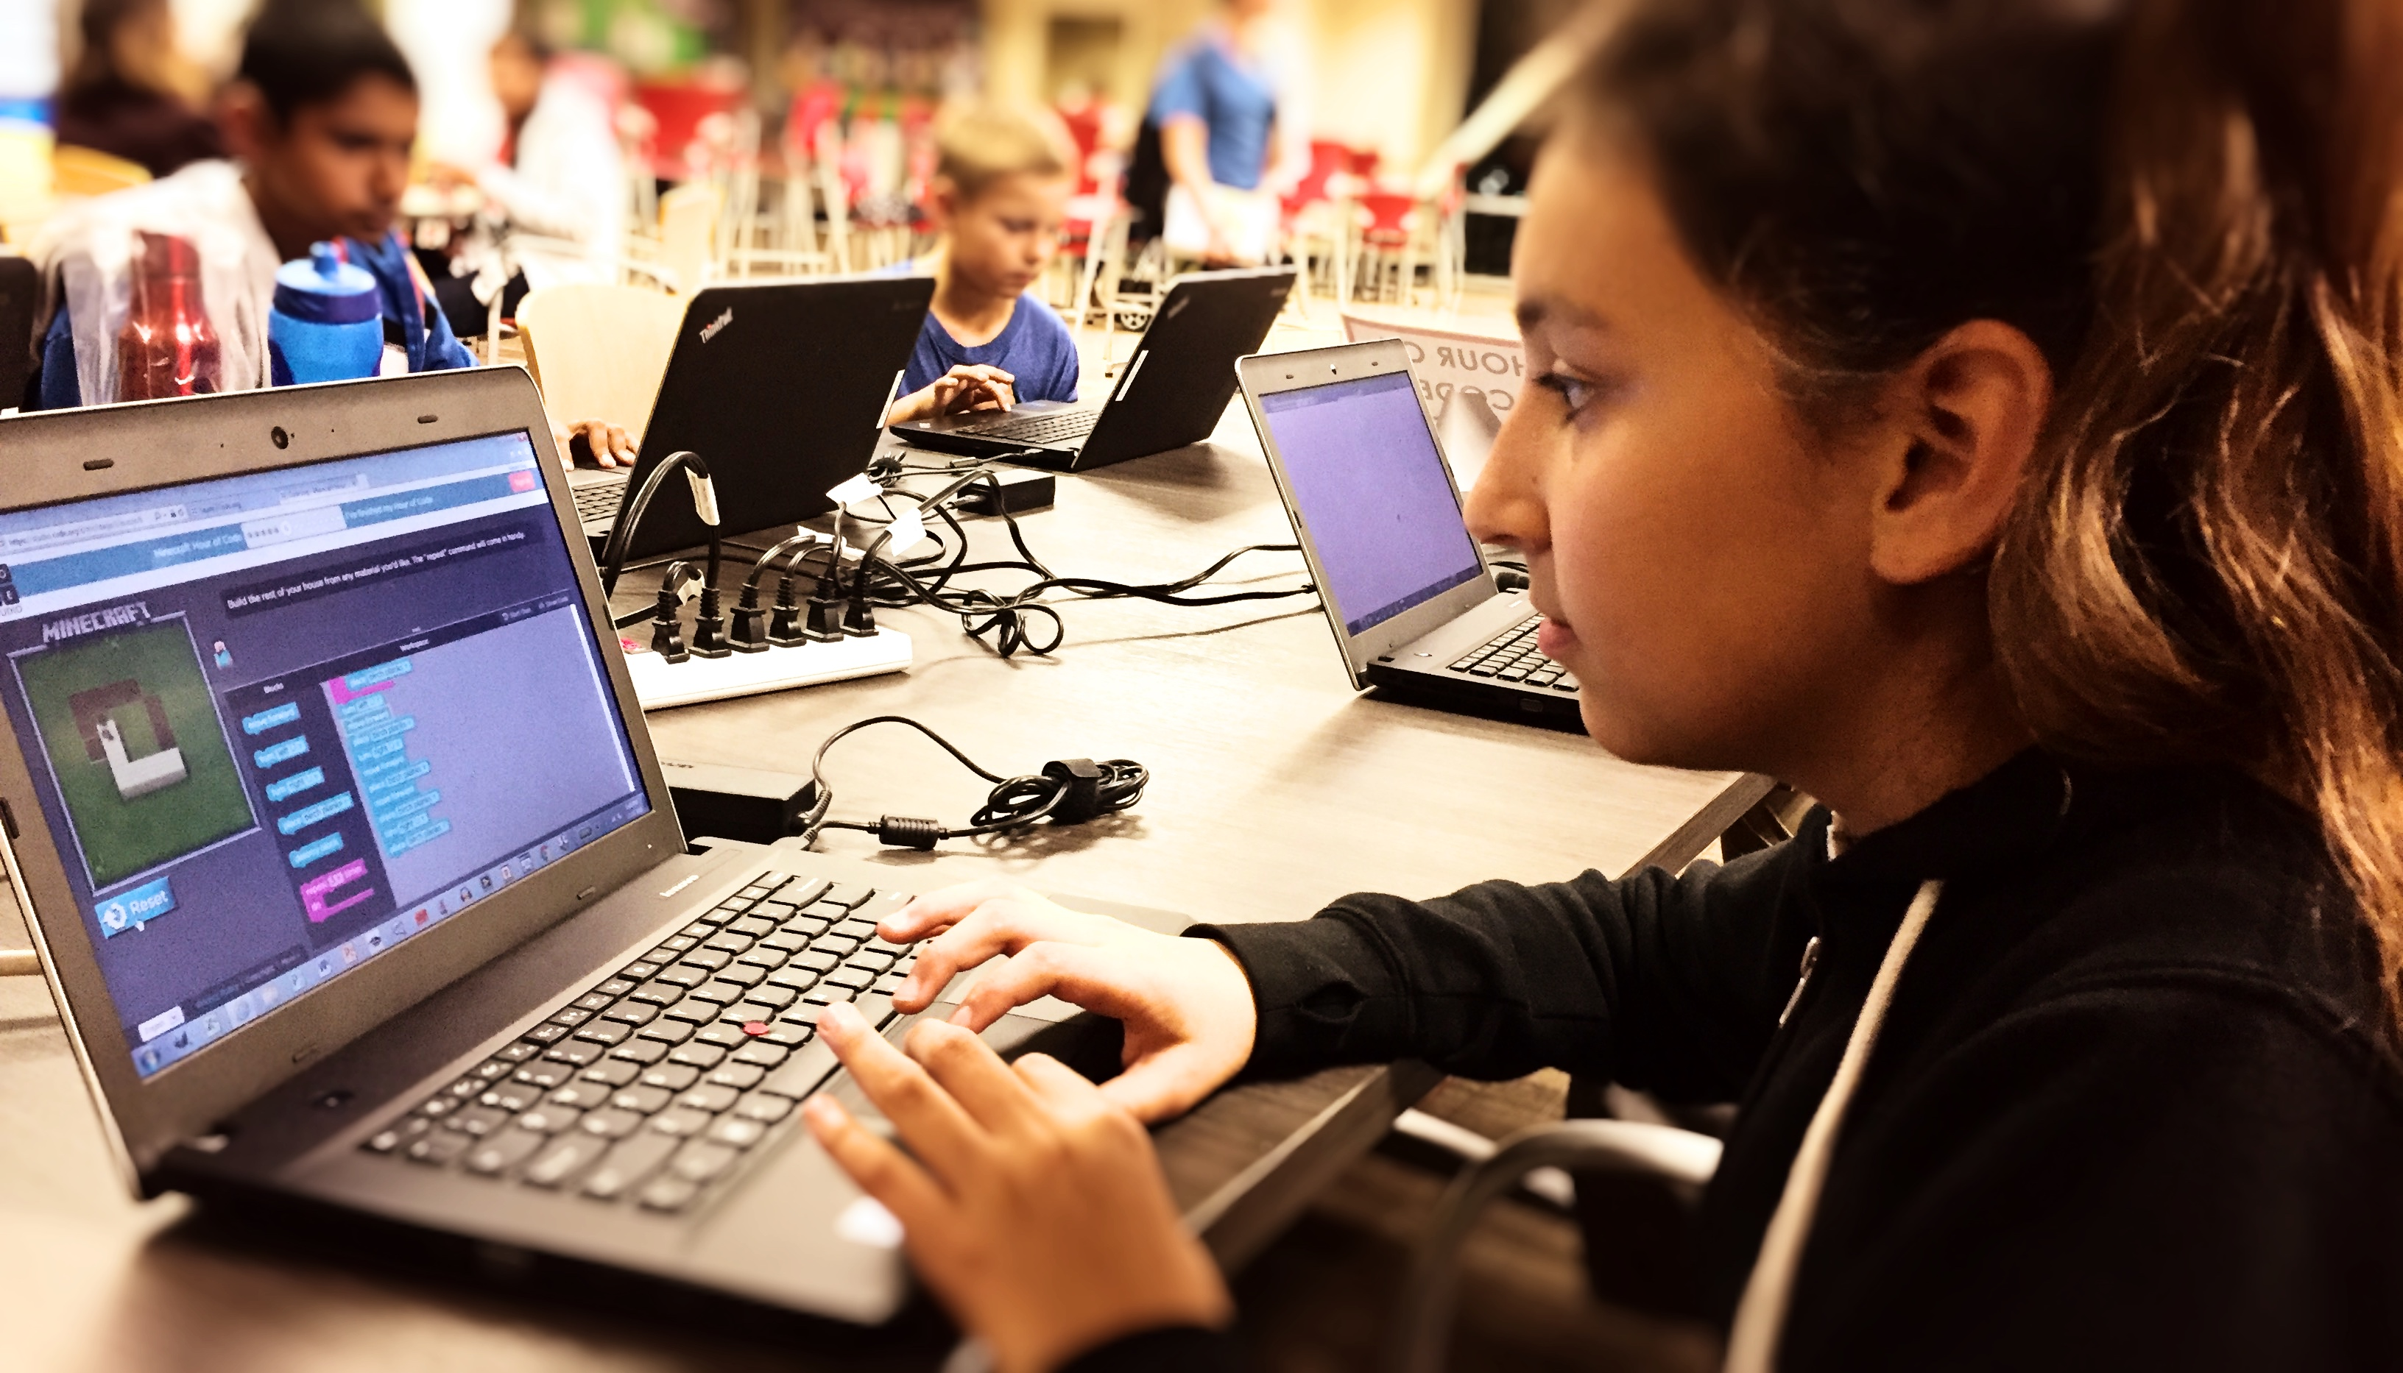
ALGORITHMS
A set of instructions that creates order within the game:
You follow a recipe in order to bake a cake.
A software engineer programs the specific code to allow a character to interact within the virtual world.
Activity: Draw a cake using algorithms

Slide 12
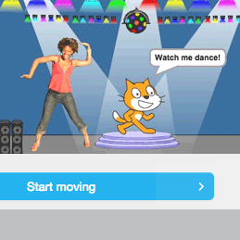
ACTIVITY: LEARN TO CODE
We’re going to use Scratch to learn game design basics:
Steps:
Grab your computer and turn it on.
Using your browser, go to scratch.mit.edu.
Click the green button that says “Try it out.”
Click the “Tips” button at the top of your screen.
Click the “Create a Pong Game” tutorial.
Follow along to create your game.

Slide 13
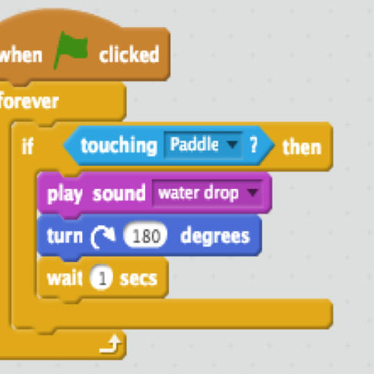
ACTIVITY: REMIX A GAME
Objectives:
Build out your if-then statements in Scratch.
Loop your desired if-then statements.
Does your intended result happen? Explain why or why not.
Write what you have learned in your Reflection Questions worksheet.

Slide 14
ACTIVITY: CREATE YOUR OWN GAME
Objectives:
“Remix” your Pong game with 5 new if-then statements.
Storyboard your own game using the elements of video games.

Slide 15
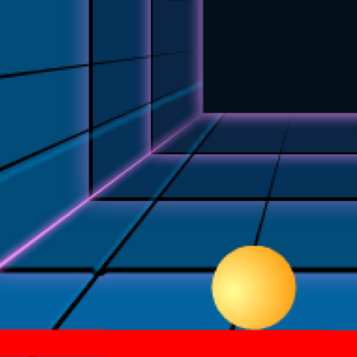
IF-THEN STATEMENTS
Logical cause-and-effect scenarios:
If the user moves their mouse, Then the paddle moves.
If the ball touches the res line, Then the game ends.
Write down 5 if-then statements that you will use to remix your Pong game

Slide 16
LOOPS
Code repeated over and over again until a certain condition is met:
In Scratch, we used “forever” and “repeat until” loops to keep the Pong game going.
Which, if any, of your if-then statements should be looped?

Slide 17
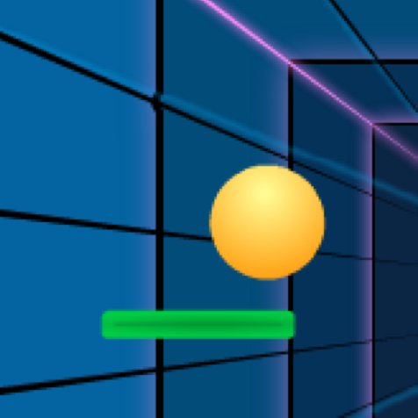
ALGORITHMS
A set of instructions that creates order within the game:
The user has to hit the ball with the paddle to earn a point.
The ball goes faster as the user continues to play, increasing the game difficulty.
Do your if-then statements create a clear algorithm?

Slide 18
REFLECTION QUESTIONS
What does each of your if-then statements add to the Pong game?
What does each of your if-then statements add to the Pong game?
Are the algorithms in your game clear? If not, do your if-then and loop statements need to be fixed? How would you improve them?
Which career would you choose in video game design and why?

Slide 19
ELEMENTS OF VIDEO GAMES
Genre
Action, adventure, puzzle, strategy, sports, role-playing, racing, shooter, family entertainment, fighting, casual, etc.
Characters
Human, animal, object,
fictional creature
Storytelling
Who are the heroes (protagonists) and the villains (antagonists)? Is the story simple (like Tetris) or complicated (like Halo)?
Objective
What is the goal of the game? How do you “win”?
User Interface (UI)
Menus, buttons, text, selection screens that let the players interact with the game
Audio
Music, voices and
sound effects

