Slide 1
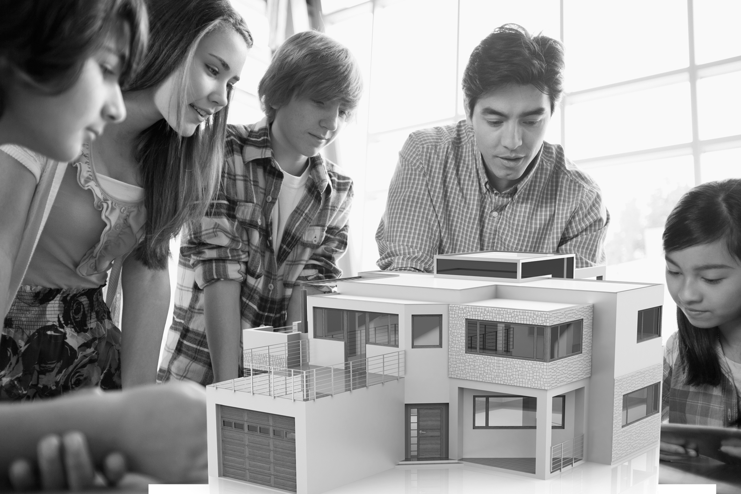
GEOMETRIC BUILDING DESIGN

Slide 2
MAP INVESTIGATIONS
Map Statements:
Teacher Note:
Edit this slide so that an image of a recognizable building/location in your community is here!
The map(s) contain shapes.
__________________________.
__________________________.
__________________________.
__________________________.
Google Maps Button

Slide 3
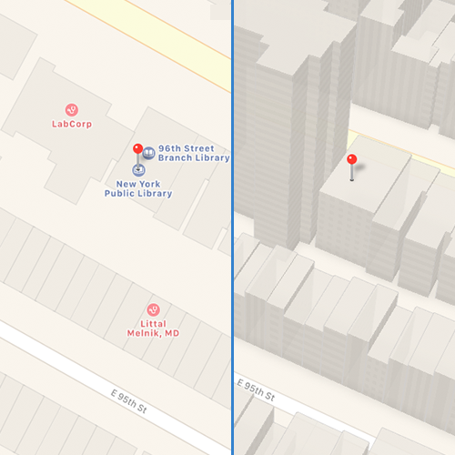

RELATIONSHIP BETWEEN 2D AND 3D SHAPES
Which map(s) contained
two-dimensional shapes?
Which map(s) contained
three-dimensional shapes?
  Discuss: How are the shapes within these two images related?

Slide 4
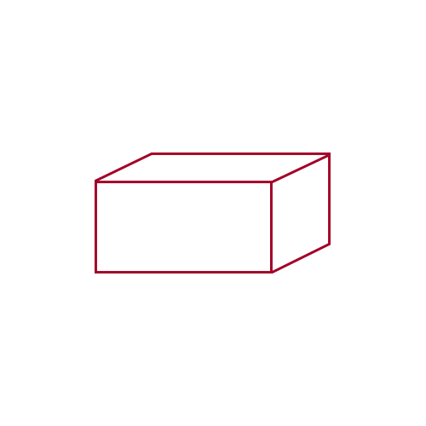
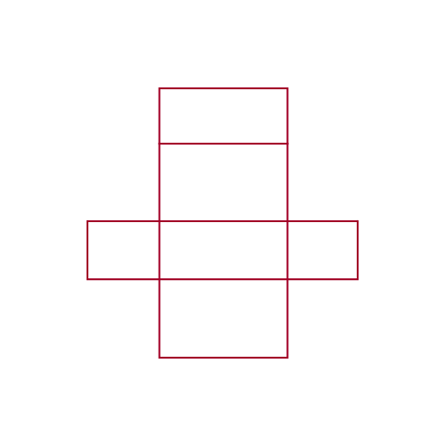
RELATIONSHIP BETWEEN 2D AND 3D SHAPES
Compare/Contrast:
How is this image similar and different to what you saw while “walking around” in Google Map’s street view?
  How is the prism related to the flat,
  2D map view?

Slide 5
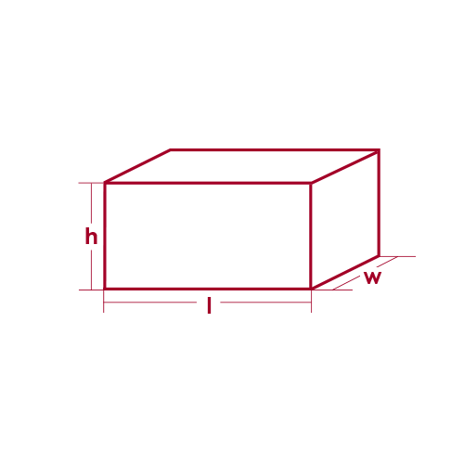
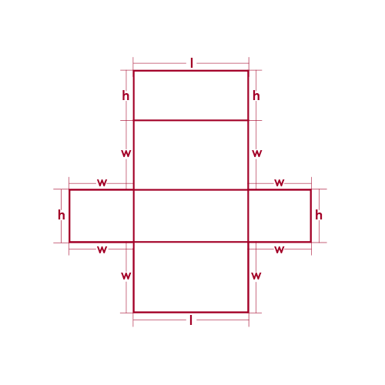
RELATIONSHIP BETWEEN 2D AND 3D SHAPES
Area and Surface Area of Rectangular Prisms
  If we know that:
  Area = Length x Width
  and
  Surface Area = The total area of the surface of a three-dimensional object
  How can we use Area to figure out Surface Area?
Surface Area = 2wl + 2lh + 2hw
If h = 20, I = 12 and w = 10
what is the surface area of the prism?

Slide 6
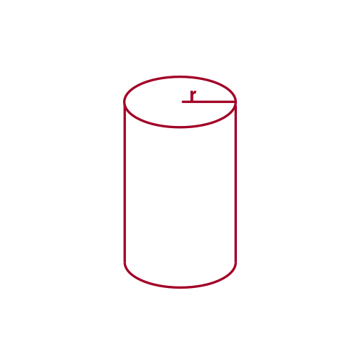
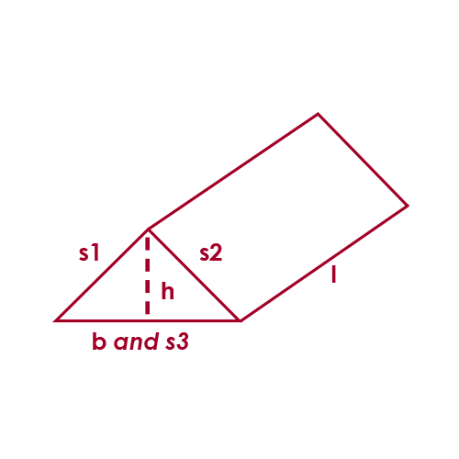
RELATIONSHIP BETWEEN 2D AND 3D SHAPES
Surface Area of Cylinders and Triangular Prisms
SA = 2πrh + 2πr²
SA = bh + (s1 + s2 + s3)l

Slide 7
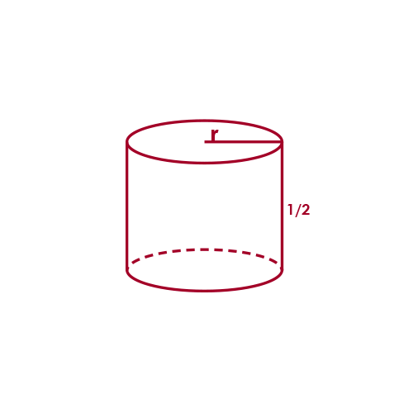
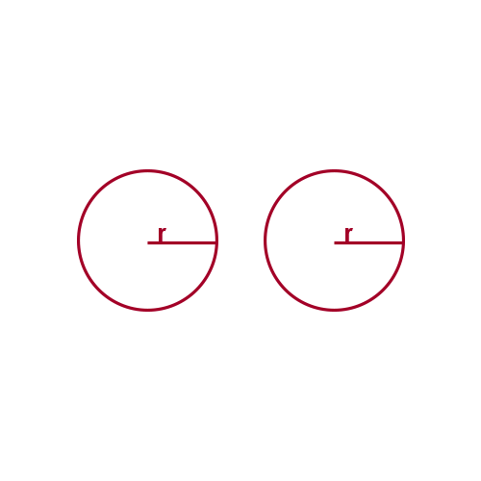
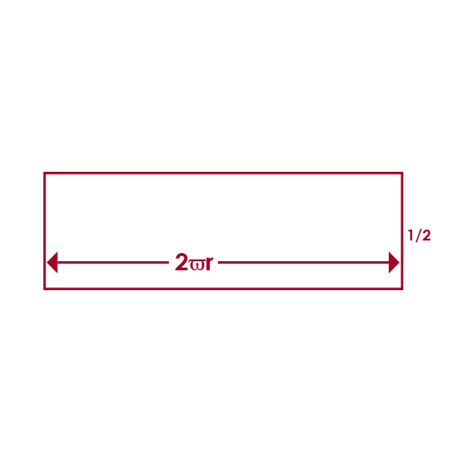
CLOSER LOOK: SURFACE AREA OF A CYLINDER
h
h
Therefore,
the Surface Area is:
SA = 2πrh + 2πr²
  Area of 2 circles:
  πr² + πr² = 2πr²
  Area of a rectangle:
  Length (which is the circumference of the circle or 2πr) x height

Slide 8

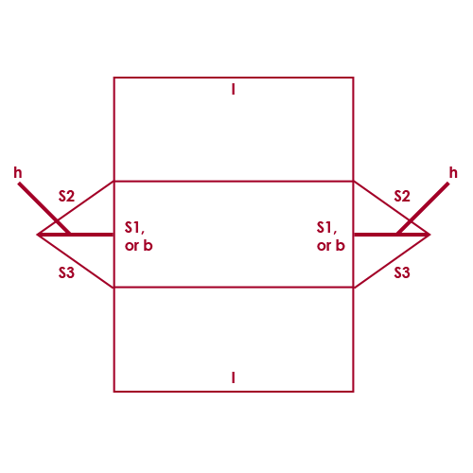
CLOSER LOOK: SURFACE AREA OF A TRIANGULAR PRISM
Variable Overview:
b = base
h = height of the triangle
s1, s2, and s3 = the length of each side of the triangle
l = the length of the rectangles
  Area of two triangles:
  1/2bh + 1/2bh = bh
  Area of three rectangles:
  s1 x l + s2 x l + s3 x l = (s1 + s2 + s3)l
  Therefore, the Surface Area is:
  SA = bh + (s1 + s2 + s3)l

Slide 9



CHALLENGE: VOLUME CALCULATIONS
Volume =
Area of the base x height
Volume =
Area of the base x height
Volume =
Area of the base x height
Challenge within a Challenge:
Now that you know the volume of a cylinder,
what is the volume of a cone?
Answer: Volume of a Cone = 1/3 (area of the base x height)

Slide 10

3D HUNT

Slide 11
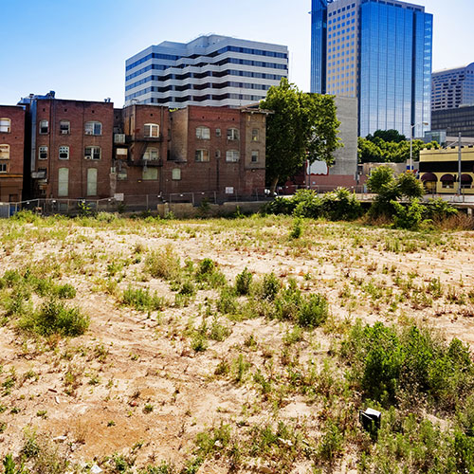
REQUEST FOR PROPOSALS
The old building down the block is being torn down next month. In its place will be an empty lot, and the city is taking proposals on what should go there. Your job will be to design and propose a new building that could go in its place. To do this, city council is asking that all proposals include a 2D and 3D representation of the design that demonstrates to scale what your proposed building would look like and how it would fit in the available space.

Slide 12
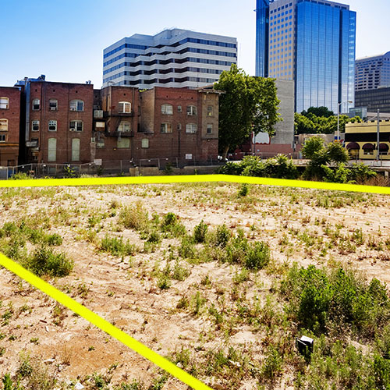
WHAT INFORMATION IS NEEDED TO CREATE A PROPOSAL?
  Size of lot: 20,000 square feet
  Shape of lot: Rectangle
  Perimeter of lot: 1800 feet
    Dimensions: The city hasn’t been able to measure this yet, but we have been told the length is 100 feet longer than the width.
  Height requirements/restrictions: None
  Additional considerations: Buildings that consider the environment and the surrounding community will be given priority review.
Task:
Create a building design for an empty lot in your community. All proposals must include a 2D and 3D representation of the design that demonstrates to scale what your proposed building would look like and how it would fit in the available space.

Slide 13
FILLING IN THE GAPS
How can we figure out the dimensions of the lot without waiting for the city to measure it?
  1800 = 2[x + (x + 100)]
  1800 = 2(x + x + 100)
  1800 = 2(2x + 100)
  1800 = 4x + 200
  1600 = 4x
  Therefore: x = 400
  Width = 400 feet and Length = 500 feet
  Perimeter of lot: 1800 feet
  Dimensions: Length is 100 feet longer than the width
X + 100
X
X
X + 100

Slide 14
TASK 1: DEVELOP A BLUEPRINT TO SCALE
Task:
Create a building design for an empty lot in your community. All proposals must include a 2D and 3D representation of the design that demonstrates to scale what your proposed building would look like and how it would fit in the available space.
Ratio: a way to compare two numbers of the same kind or two things of the same type
Class Ratio of Girls to Boys is ____________ : ______________
Ratio of _____________’s height to _____________’s height is: _____________ : _____________
  To Scale Definition:
  In a to-scale drawing, every part of the drawing is smaller or larger than the original by a certain ratio.

Slide 15
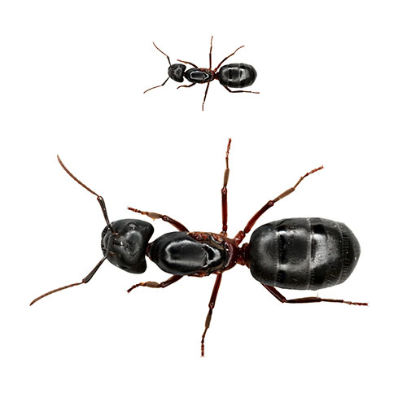
TASK 1: DEVELOP A BLUEPRINT TO SCALE
  To Scale Definition:
  In a to-scale drawing, every part of the drawing is smaller or larger than the original by a certain ratio.
Scale of 1:10
The image is 10x smaller than the actual object: It has an actual size of 10 units but is drawn at a size of 1 unit.
Scale of 10:1
The image is 10x larger than the actual object. It has an actual size of 1 unit but is drawn at a size of 10 units.

Slide 16
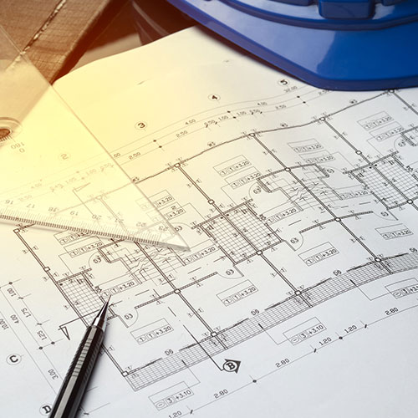
TASK 1: DEVELOP A BLUEPRINT TO SCALE

Slide 17
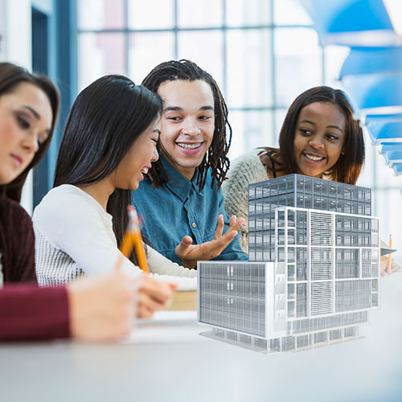
TASK 1: DEVELOP A BLUEPRINT TO SCALE
Peer Review:
  Are you able to read and understand the blueprint?
  Are any dimensions missing or has anything been overlooked?

Slide 18
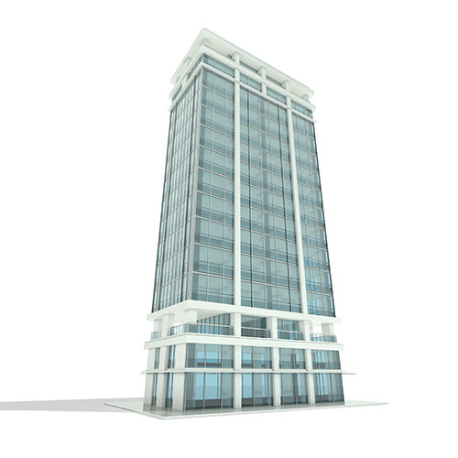
TASK 2: DEVELOP A 3D MODEL TO SCALE

Slide 19
TASK 2: DEVELOP A 3D MODEL TO SCALE
Reminders:
Follow the directions on your 3D Construction Handout.
Consider the thoughts and opinions of all group members as you build your model.
Have a question? Raise your hand!

Slide 20
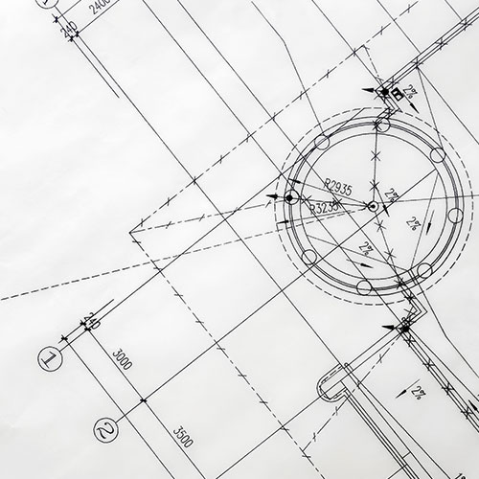
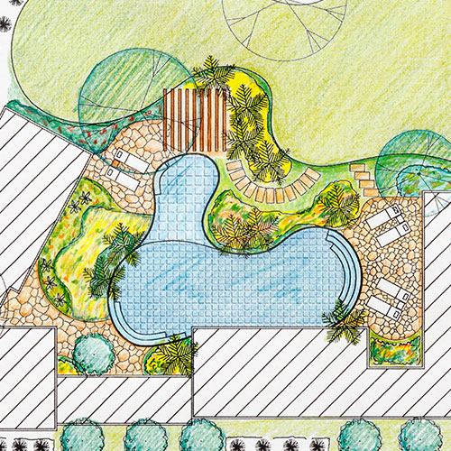
TASK 2: DEVELOP A 3D MODEL TO SCALE
Challenge Opportunities
Option 1
Create more of the internal facility (structures, building features, etc.) within the volume and dimension constraints.
Option 2
Design a communal green space outside the building that the community could use. Think about native plants and animals that you may want to include in this space!

Slide 21
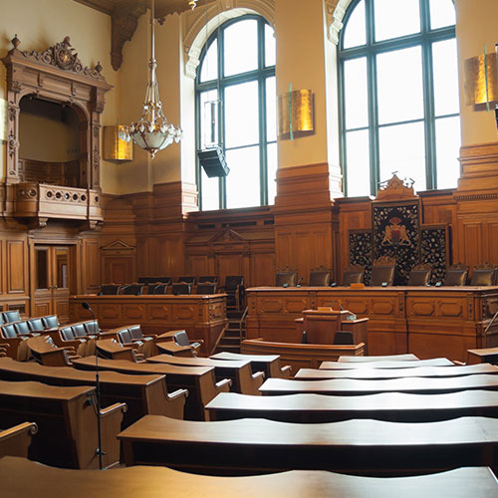
CITY COUNCIL PRESENTATION PREP

Slide 22
CITY COUNCIL PRESENTATION PREP
Welcome to the ______ City Council

Slide 23
WINNING PRESENTATION
The winning proposal is…

