Slide 1
RETHINKING FAILURE

Slide 2
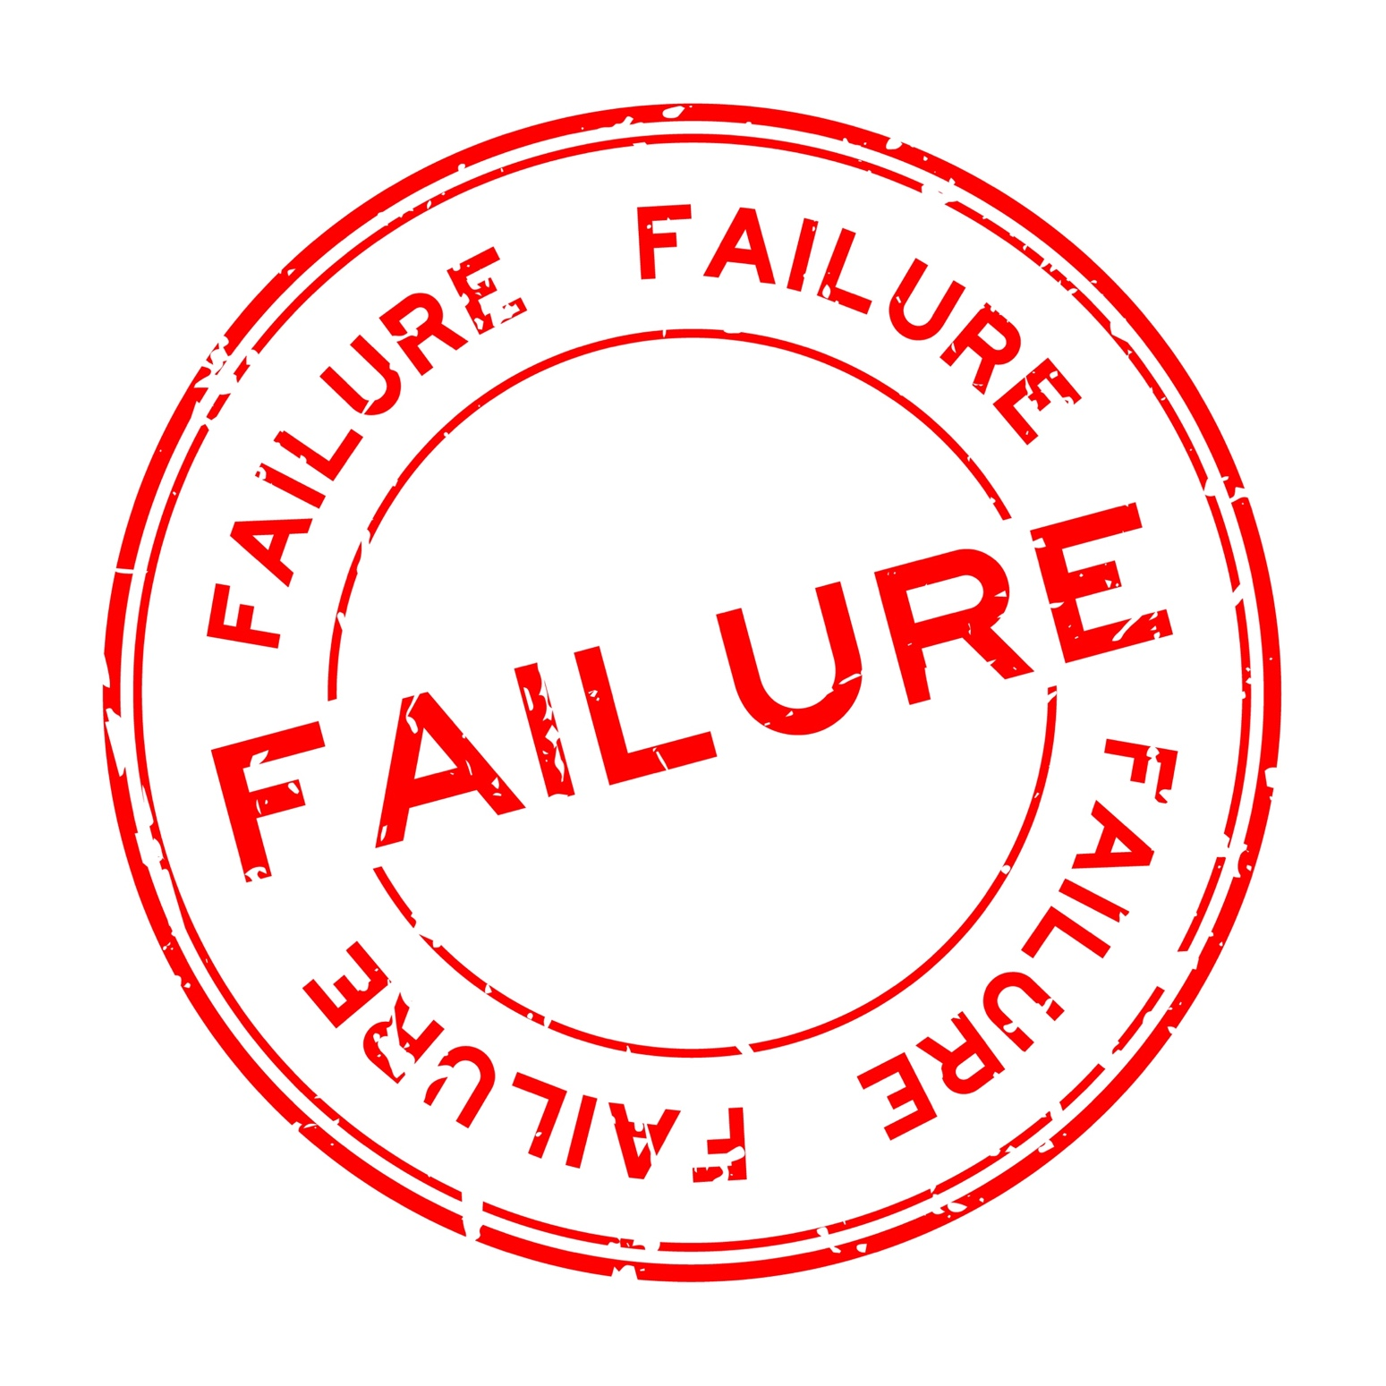
WHAT IS FAILURE?
What does it mean?
What does it look like?
What does it feel like?
How does it affect us?
Why do we fear it?

Slide 3
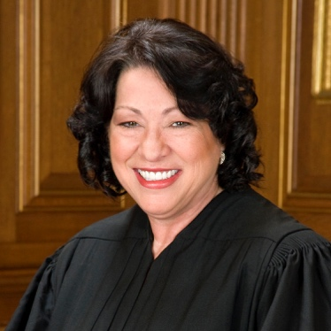
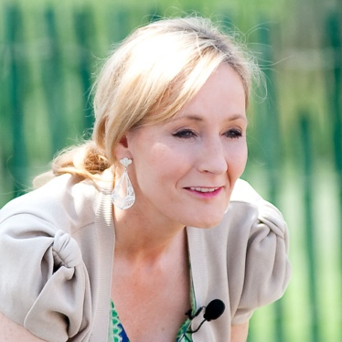
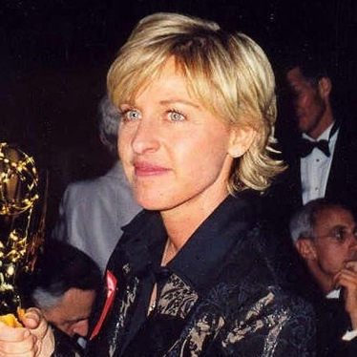
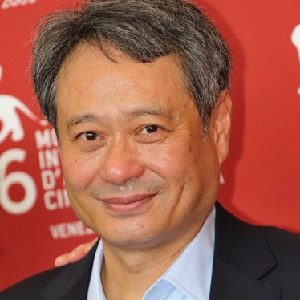
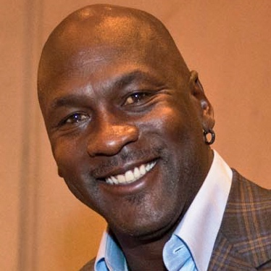
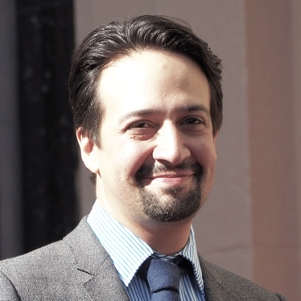
GALLERY WALK
What do they all have in common?
Brainstorm reasons they are/were successful.
Watch Video

Slide 4
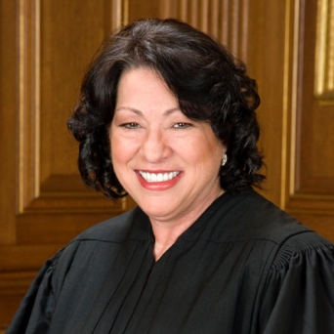
JOURNEY TO SUCCESS
Let’s take a closer look at these people and their journeys to success.

Slide 5
J.K. ROWLING, AUTHOR
Philanthropist and best-selling author J.K. Rowling was a single mom living on welfare when she began writing the first Harry Potter novel.
“It is impossible to live without failing at something unless you live so cautiously that you might as well not have lived at all in which case you have failed by default.”

Slide 6
SONIA SOTOMAYOR, SUPREME COURT JUSTICE
In her memoir, Sonia writes of chronic disease, troubled family relationships and a failed marriage that accompanied her rise from a housing project in the Bronx to a seat on the Supreme Court.
“You know, failure hurts. Any kind of failure stings. If you live in the sting, you will – undoubtedly – fail. My way of getting past the sting is to say no, I’m just not going to let this get me down.”

Slide 7
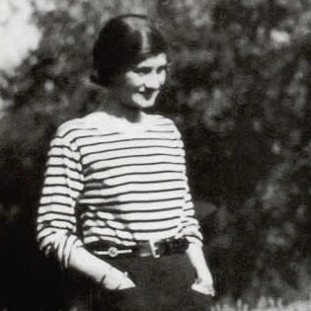
COCO CHANEL, FASHION DESIGNER
Against all odds, Coco made an infamous return to the fashion industry when was nearly 70 years old. She rebuilt her entire brand and reputation, despite the constant badgering from her many critics about her age.
“Success is most often achieved by those who don’t know that failure is inevitable.”

Slide 8
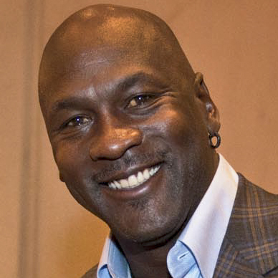
MICHAEL JORDAN, PROFESSIONAL ATHLETE
Now considered one of the greatest basketball players of all time, Michael was devastated when he was cut from the varsity basketball team during his sophomore year in high school.
“I have missed more than 9,000 shots in my career. I have lost almost 300 games. On 26 occasions I have been entrusted to take the game winning shot and I missed. I have failed over and over and over again in my life. And that is why I succeed.”

Slide 9
LIN-MANUEL MIRANDA, COMPOSER/PLAYWRIGHT/ACTOR
The musical “Hamilton” has won many awards, but it was not an overnight success. It took Lin-Manuel a full year to write one song from the show, “My Shot.” Although people he trusted told him to give up on the project, he worked seven years to finish it.
“I try to let my decisions be guided not by what I think will succeed or fail, but what I'm going to learn from that process.”

Slide 10
OPRAH WINFREY, MEDIA EXECUTIVE/ACTOR
Known worldwide for her work in entertainment and philanthropy, Oprah Winfrey was publicly fired from
her first job as a news anchor for getting ‘too emotionally invested in her stories.’
"It doesn't matter how far you might rise. At some point you are bound to stumble. If you're constantly pushing yourself higher and higher the law of averages predicts that you will at some point fall. And when you do I want you to remember this: There is no such thing as failure. Failure is just life trying to move us in another direction."

Slide 11
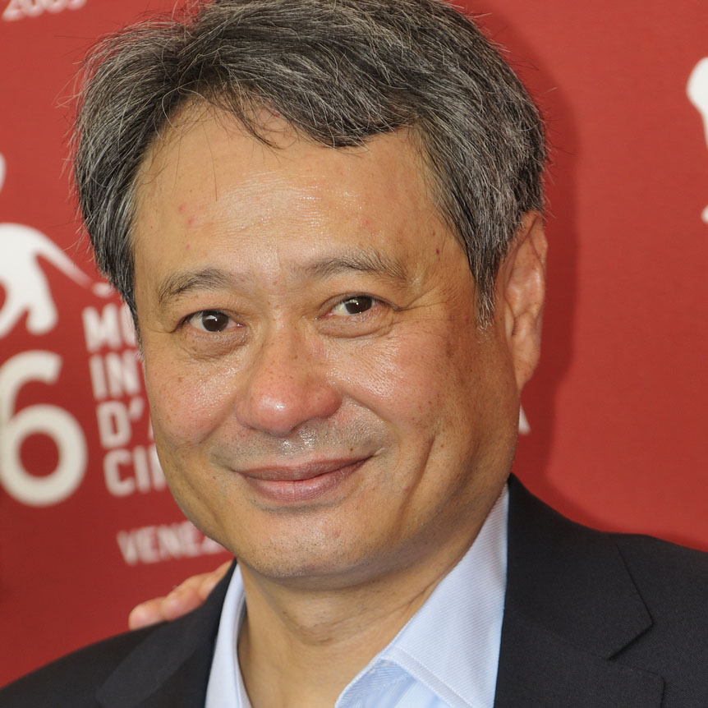
ANG LEE, DIRECTOR
Oscar-winning film director Ang Lee failed Taiwan's college entrance exams — twice. Then he tried to go to acting school but his English was not considered good enough.
“Many times when you make a movie, it feels like your biggest mistake. But even if a film isn't a hit, you shouldn't view it as a mistake.”

Slide 12
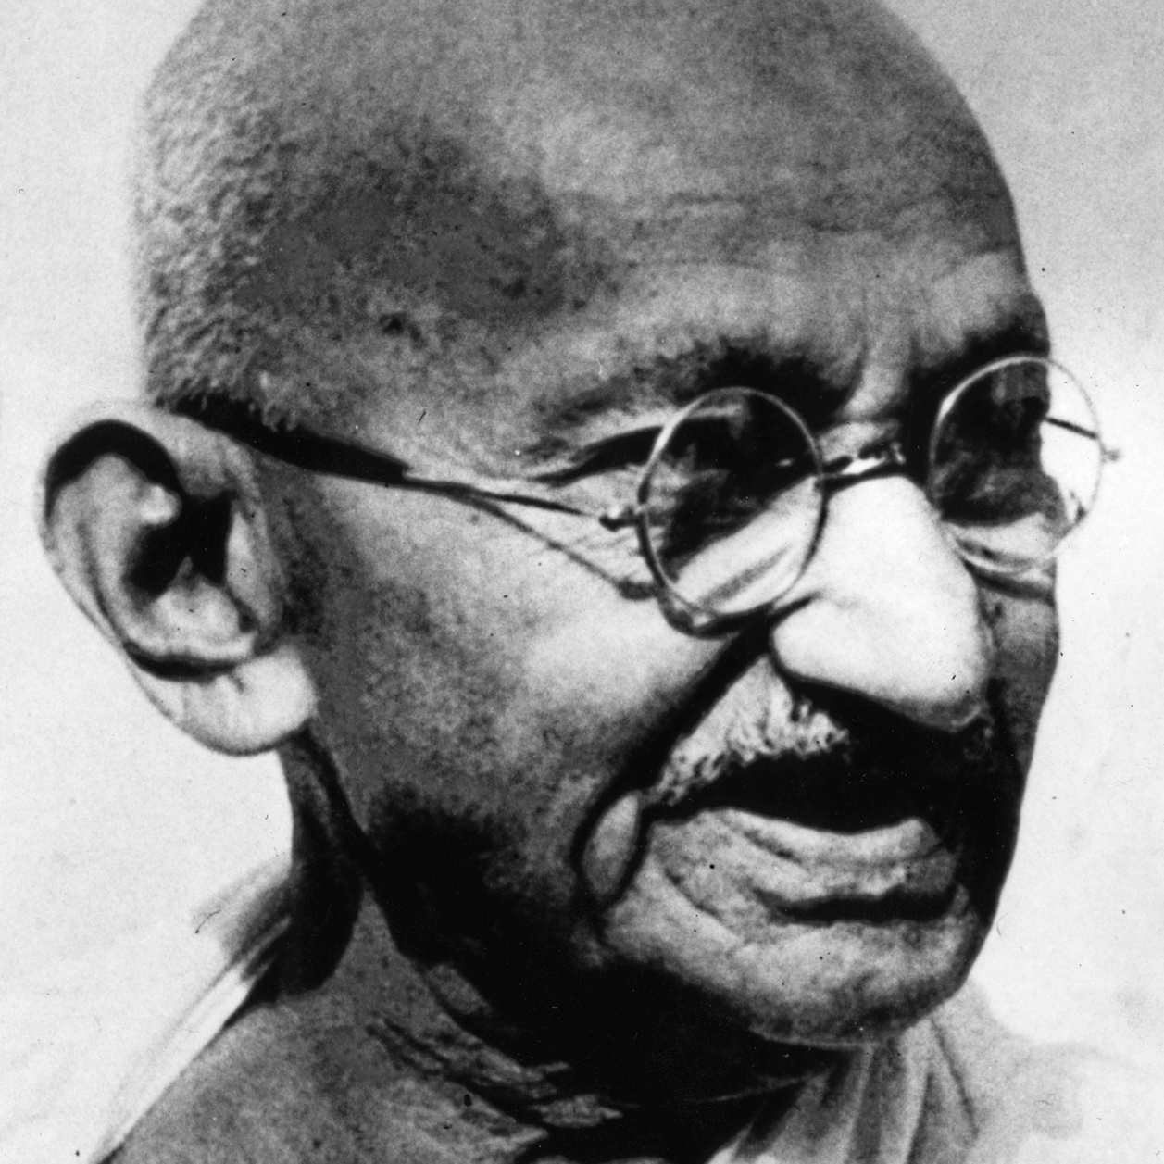
MAHATMA GANDHI, ACTIVIST
Following his civil disobedience campaign, Gandhi was sentenced to six years in jail for conspiracy. He has come to be known as the Father of India and promoted non-violence, justice and harmony between people of all faiths.
“It is unwise to be too sure of one’s own wisdom. It is healthy to be reminded that the strongest might weaken and the wisest might err.”

Slide 13
ELLEN DeGENERES, COMEDIAN/TV HOST/PRODUCER
A year after publicly coming out as gay in 1997, Ellen’s sitcom was canceled and she thought her career in entertainment was over. As of 2018, she had won 14 Emmy awards for her daytime talk show.
“When you take risks you learn that there will be times when you succeed and there will be times when you fail, and both are equally important.”

Slide 14
WHAT IS FAILURE?
“When you take risks you learn that there will be times when you succeed and there will be times when you fail, and both are equally important.”
– Ellen DeGeneres
“I have missed more than 9,000 shots in my career. I have lost almost 300 games. On 26 occasions I have been entrusted to take the game winning shot and I missed. I have failed over and over and over again in my life. And that is why I succeed.”
– Michael Jordan
"It doesn't matter how far you might rise. At some point you are bound to stumble. If you're constantly pushing yourself higher and higher the law of averages predicts that you will at some point fall. And when you do I want you to remember this: There is no such thing as failure. Failure is just life trying to move us in another direction."
– Oprah Winfrey
“Success is most often achieved by those who don’t know that failure is inevitable.”
– Coco Chanel
“You know, failure hurts. Any kind of failure stings. If you live in the sting, you will – undoubtedly – fail. My way of getting past the sting is to say no, I’m just not going to let this get me down.”
– Sonia Sotomayor
“I try to let my decisions be guided not by what I think will succeed or fail, but what I'm going to learn from that process.”
– Lin-Manuel Miranda
“It is impossible to live without failing at something unless you live so cautiously that you might as well not have lived at all in which case you have failed by default.”
– J.K. Rowling
“Many times when you make a movie, it feels like your biggest mistake. But even if a film isn't a hit, you shouldn't view it as a mistake.” – Ang Lee
“It is unwise to be too sure of one’s own wisdom. It is healthy to be reminded that the strongest might weaken and the wisest might err.” – Mahatma Gandhi

Slide 15
LESSONS LEARNED
Write down one thing you have learned or one insight you have gained about failure today.

Slide 16
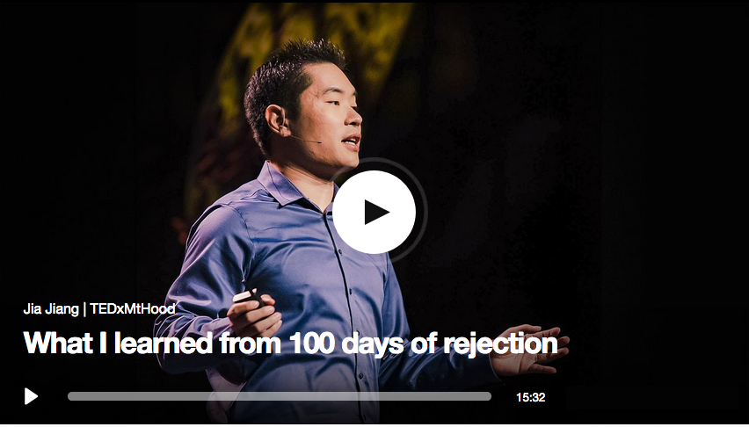
LESSONS LEARNED

Slide 17
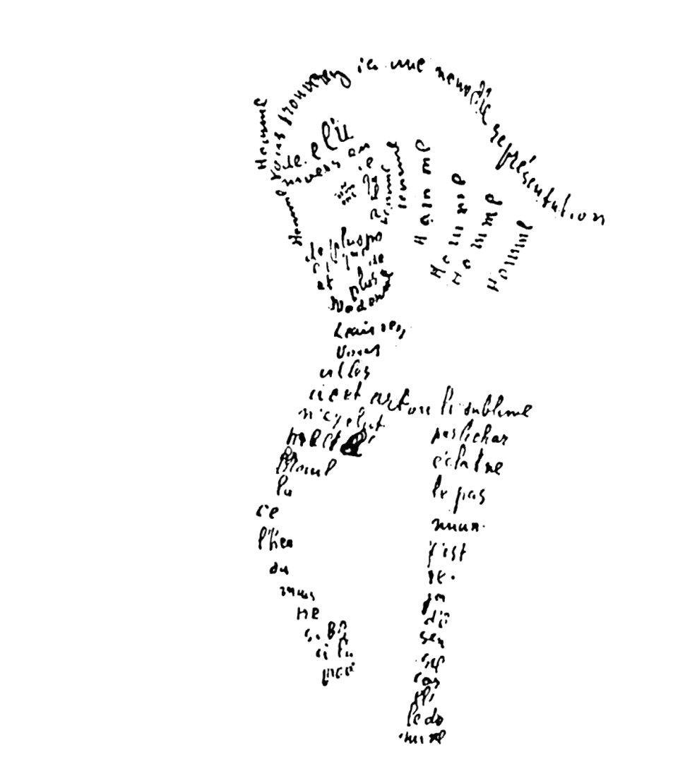
MAKE IT CONCRETE
To create your concrete shape poem, draw the outline of one image or a series of images, that represent the main concept of the video segment.
Fill in the outline of each shape with facts you learned about failure and rejection from watching the video.

Slide 18
THE FAILURE OF SUCCESS AND THE SUCCESS OF FAILURE
Find a partner.
Identify a successful individual you would like to research.
Work with your partner to research the individual you chose.
Use your research to create a “résumé of failures” for your research subject. Your résumé should include the following:
Career(s)
Ways in which your selected individual experienced failure before becoming successful in their career(s)
Lessons they learned that fueled their future successes

Slide 19
THE FAILURE OF SUCCESS AND THE SUCCESS OF FAILURE
Think about a member of school personnel you would like to interview about their experiences with failure and success.
Work with the teacher to develop a list of 3-5 interview questions.
Form a small group of 3-4 people who are interested in interviewing the same individual.
Using the interview questions we created as a class, work with your small group to interview your selected individual.

Slide 20
THE FAILURE OF SUCCESS AND THE SUCCESS OF FAILURE
Think about your celebrity “résumés of failure” and your interviews with school personnel.
Are you surprised about the stories shared by your classmates? The commonalities and differences?
What takeaways do you have because of these exercises?
Which do you think is the more effective teacher – success or failure? Why?

Slide 21
WHAT IS INTELLIGENCE?
Are we born smart or do we become smart?
Can intelligence change or is it fixed?
Is there more than one way to be intelligent?
Why does it matter?

Slide 22
DEVELOPING A GROWTH MINDSET
Fixed Mindset
Growth Mindset
Believe intelligence cannot change
Do not see the value in working to develop and improve intelligence
Believe talent equals success
Believe intelligence can grow with time and experience
Put in extra time to develop and improve intelligence
Believe effort can lead to success

Slide 23
DEVELOPING A GROWTH MINDSET

Slide 24
THE LANGUAGE OF MINDSETS
Take the fixed vs. growth mindset phrases out of the envelope and read them with your small group members.
Work with your group to decide whether each phrase is an example of a fixed mindset or a growth mindset. Sort the phrases into two piles.
Be prepared to explain how you sorted the phrases.

Slide 25
THE LANGUAGE OF MINDSETS
If you are comfortable doing so, share some of your personal experiences with positive and negative self-talk.
Does it really matter how we talk to and think about ourselves? Why? What does this have to do with rethinking failure?

Slide 26
RETHINKING FAILURE: FINDING THE SILVER LINING

Slide 27
NOW WHAT?
NOW
WHAT?
Develop Your Slogan
About Failure!

Slide 28
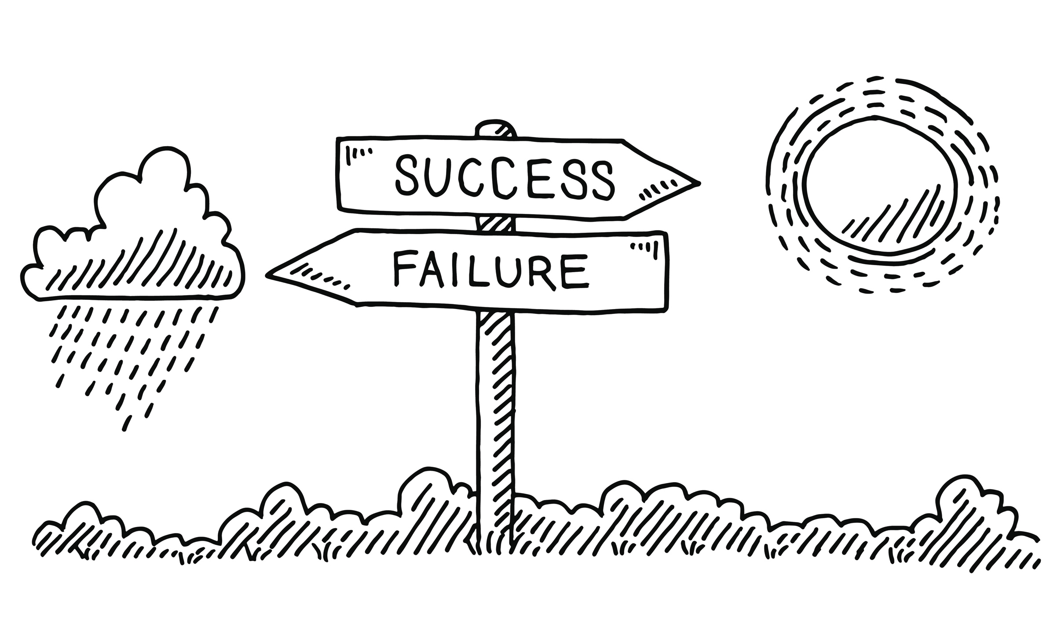
RETHINKING FAILURE
Draw what failure looks and feels like to you now.

