Slide 1
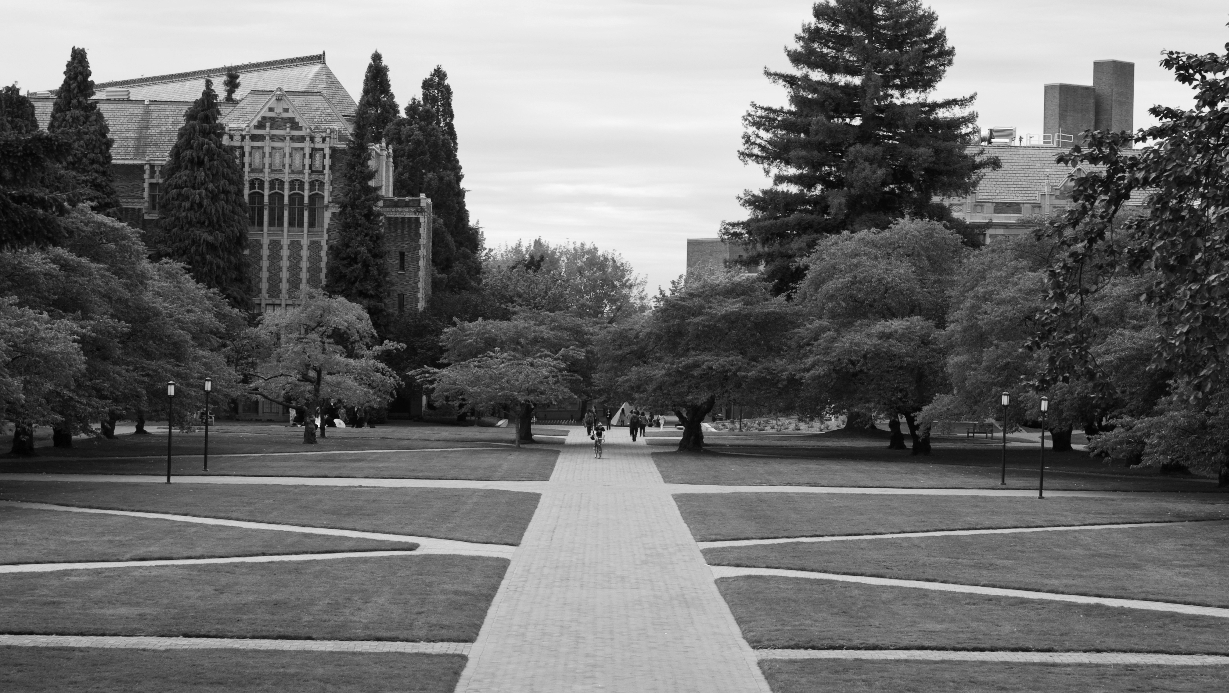
SCHOLARSHIP CASE STUDY

Slide 2
SCHOLARSHIPS: DID YOU KNOW?
Scholarships:
Are a form of financial aid that helps students pay for college.
Are awarded based on different criteria.
Do not have to be paid back!
Remember: All the financial aid a student receives may not exceed the amount needed to pay for the total cost of college (tuition, room and board, materials, fees, etc.).

Slide 3
TWO GENERAL TYPES OF SCHOLARSHIPS
There are two general categories for scholarships. Those awarded based on:
Merit
Financial Need

Slide 4
STAND UP IF YOU…
Have brown eyes
Are part of the student government
Like ice cream
Are into zombie apocalypses
Can do duck calls
Like duct tape
Speak Klingon
Like to make others laugh
Like animals
Like to fish

Slide 5
CHECK YOUR LIST
Academic – for grades, academic achievements
Athletic – for sports (i.e. football, volleyball, tennis, golf, etc.)
Careers – offered by professional organizations or unions
Corporate – offered by companies such as Coca-Cola, Microsoft, Burger King, etc. (sometimes to their employees, sometimes to anyone)
College – specific to the college/university you want to attend
Community-based – offered by local groups, organizations, clubs or for community involvement or activism
Skill or talent-based – offered by arts-based or creative organizations and groups
Background-specific – offered for students with special needs, medical issues, family situations, or for race, gender, ethnicity, religious affiliation, LGBTQI, etc.
Combination – for example, academic and community service, or athletic and need-based

Slide 6
CONCENTRIC CIRCLES

Slide 7
BRIGHTYOUNG CHAMPIONS FOUNDATION SCHOLARSHIP APPLICATION
Why do you think BrightYoung Champions Foundation requires the following from each scholarship applicant?
A Completed Application Form
Academic Résumé
Official High School Transcript
Community Service Log
Short Answer Questions

Slide 8
COMPARE THESE TWO SCHOLARSHIP APPLICANTS
Student A
Student B
Name: Angel Gonzales
School: Ellington High School
Race/Ethnicity: Hispanic
Date of Birth: 11/10/2000
Address: 1532 17th St. N.W.
City: Washington, D.C.
Lives with: Mother
Highest level of mother’s completed education: Some high school
Mother’s occupation: Retail Sales Clerk
Total yearly income: $35,000
Name: Tamika Jones
School: Kennedy High School
Race/Ethnicity: African-American
Date of Birth: 10/01/2000
Address: 2902 Ft. Baker Drive S.E.
City: Washington, D.C.
Lives with: Mother and Father
Highest level of mother’s completed education: High school diploma
Highest level of father’s completed education: High school diploma
Mother’s occupation: Homemaker
Father’s occupation: Food Service
Total yearly income: $36,500

Slide 9
LET’S REVIEW
Scholarships:
Are a form of financial aid to help pay for college.
Are awarded based on different criteria.
Don’t have to be paid back!
Two categories of scholarships:
Merit
Financial Need
Most scholarship applications require:
A Completed Application Form
Official High School Transcript
Short Answer Questions
It’s important to:
Do research.
Look for as many scholarship opportunities as possible.
Read the requirements for each one carefully!

Slide 10
BRIGHTYOUNG CHAMPIONS FOUNDATION SCHOLARSHIP APPLICANTS
Jermaine Moore
Carina Nguyen
Isabel Castro
Review the requirements again.
Review the three applicants by yourself.
Work in small groups to discuss the applicants and score the applications.
Use the rubric to decide which applicant should get the scholarship.
Report your decision and justification to the whole class.

Slide 11
WHO GETS THE SCHOLARSHIP?
Jermaine Moore
Carina Nguyen
Isabel Castro

Slide 12
FOR MORE INFORMATION
Finding scholarships
Avoiding scholarship scams

